Slide 1


Striving for SDR Performance Portability in the Era of Heterogeneous SoCs
Jeffrey S. Vetter
Seyong Lee
Mehmet Belviranli
Roberto Gioiosa
Richard Glassbrook
Abdel-Kareem Moadi
GNU Radio Conference 2019
Huntsville, Alabama
16 Sep 2019
ORNL is managed by UT-Battelle for the US Department of Energy
http://ft.ornl.gov vetter@computer.org

Slide 2
Highlights
Motivation: Recent trends in computing paint an ambiguous future
Contemporary systems provide evidence that power constraints are driving architectures to change rapidly
Multiple architectural dimensions are being (dramatically) redesigned: Processors, node design, memory systems, I/O
Complexity is our main challenge
Applications and software systems across many areas are all reaching a state of crisis
Applications will not be functionally or performance portable across architectures
Programming and operating systems need major redesign to address these architectural changes
Procurements, acceptance testing, and operations of today’s new platforms depend on performance prediction and benchmarking.
ORNL Cosmic project investigating design and programming challenges for these trends in SDR
Performance modeling and ontologies
Performance portable compilation to many different heterogeneous architectures/SoCs
Intelligent scheduling system to automate discovery, device selection, and data movement
Targeting wide variety of existing and future architectures (DSSoC and others)

Slide 3
Motivating Trends

Slide 4
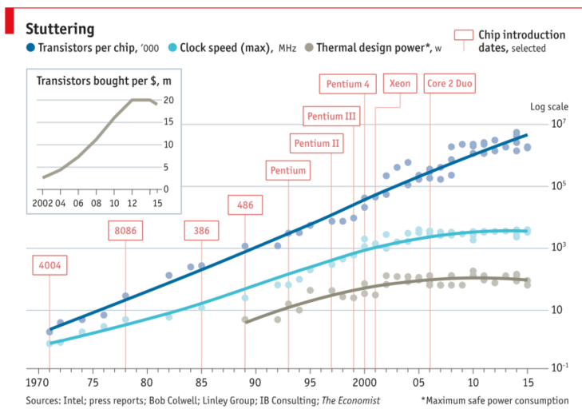
Contemporary devices are approaching fundamental limits
Economist, Mar 2016
Dennard scaling has already ended. Dennard observed that voltage and current should be proportional to the linear dimensions of a transistor: 2x transistor count implies 40% faster and 50% more efficient.
R.H. Dennard, F.H. Gaensslen, V.L. Rideout, E. Bassous, and A.R. LeBlanc, “Design of ion-implanted MOSFET's with very small physical dimensions,” IEEE Journal of Solid-State Circuits, 9(5):256-68, 1974,
I.L. Markov, “Limits on fundamental limits to computation,” Nature, 512(7513):147-54, 2014, doi:10.1038/nature13570.

Slide 5

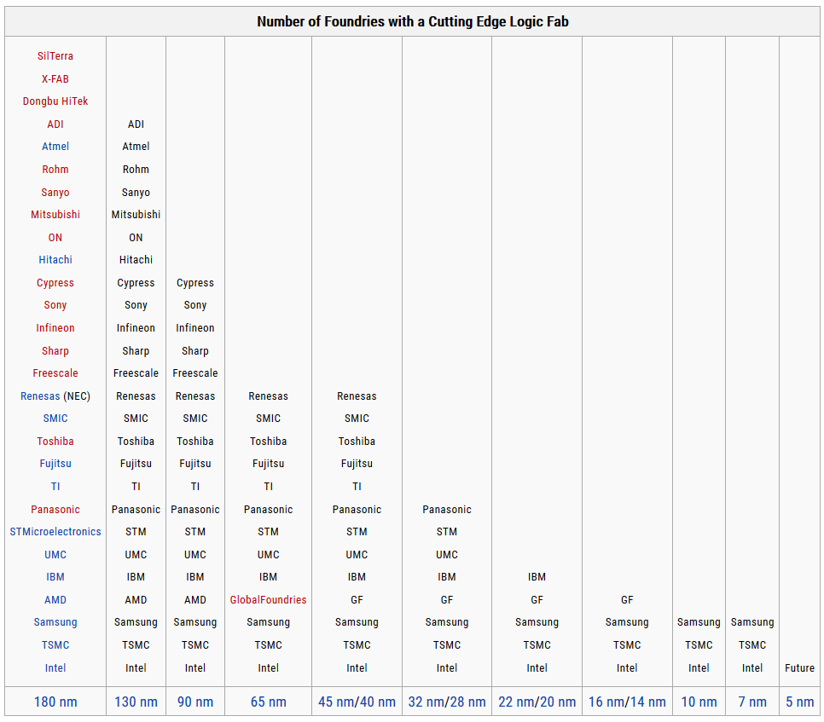

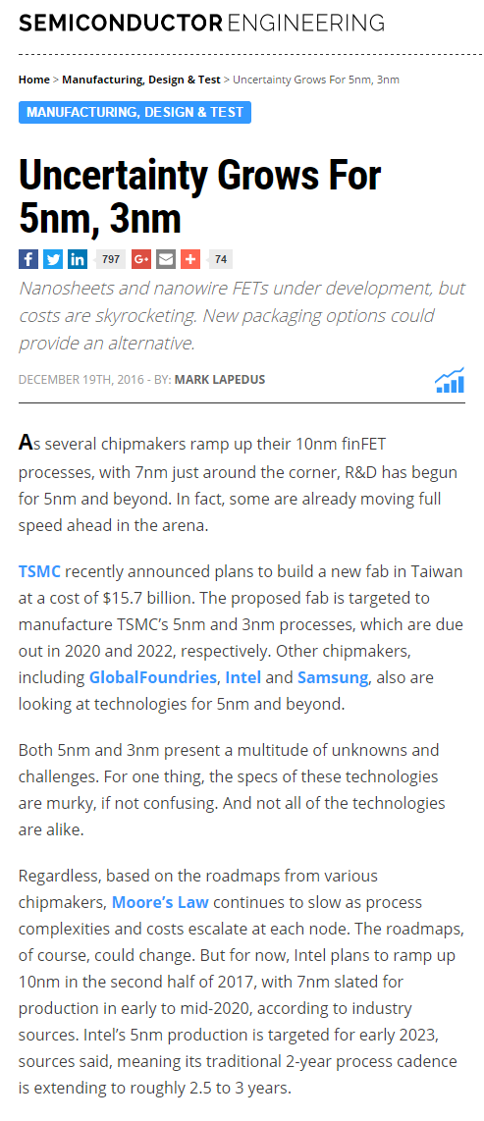
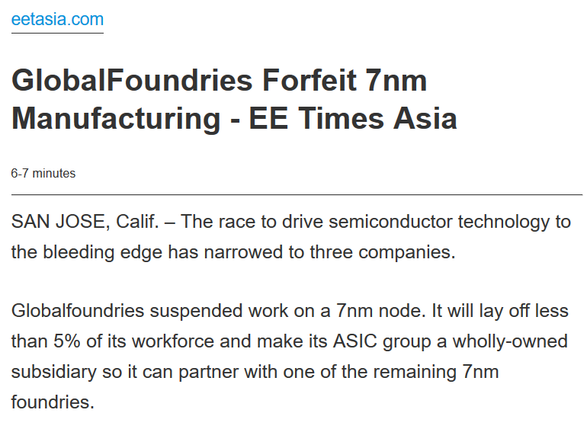
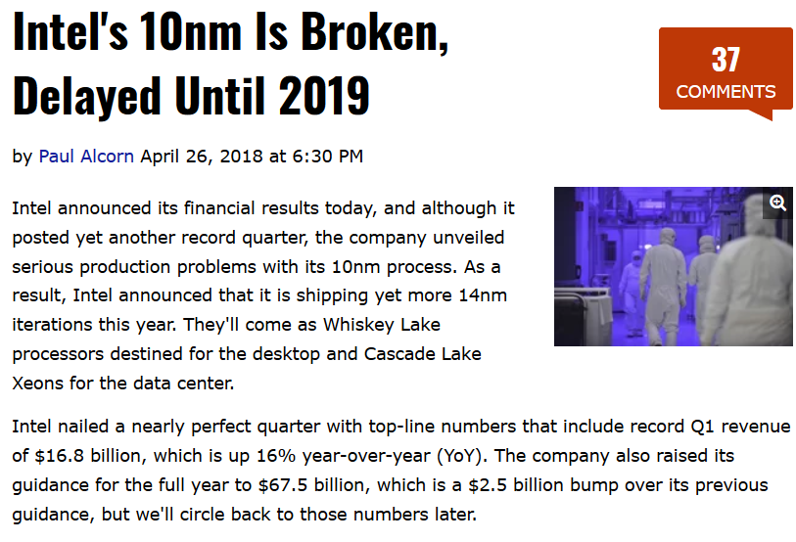
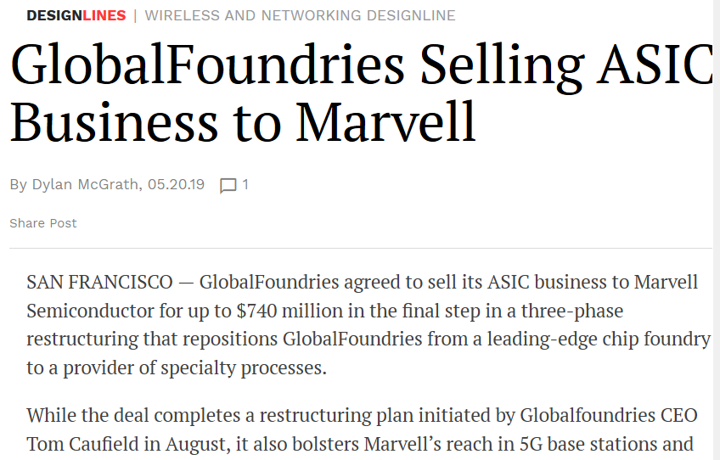
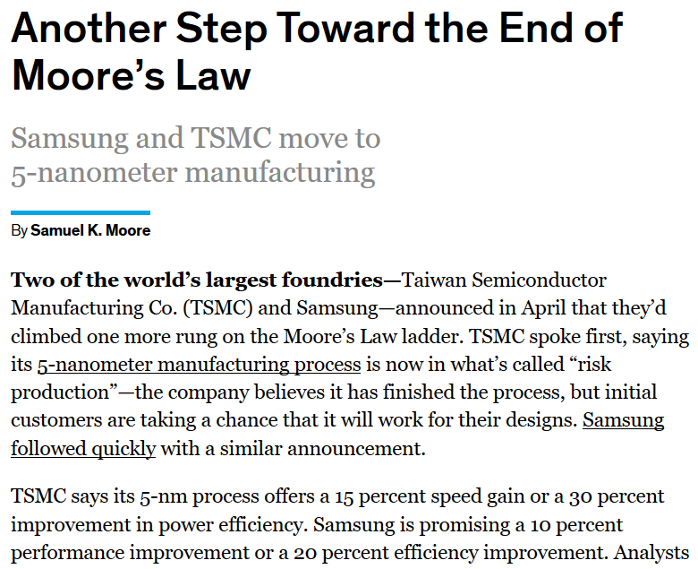

Slide 6

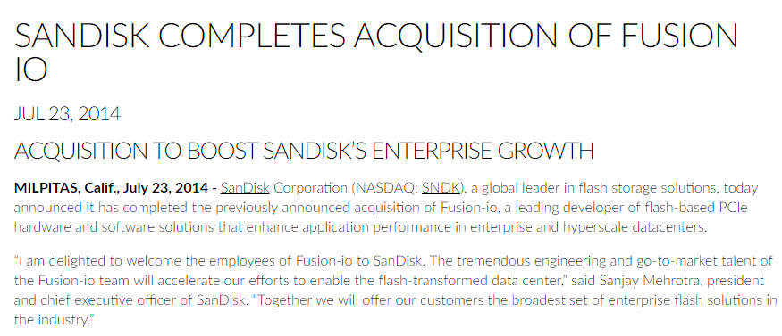
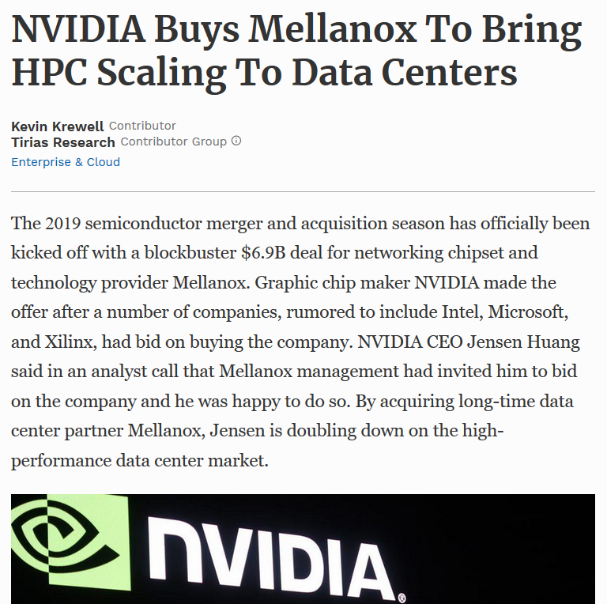

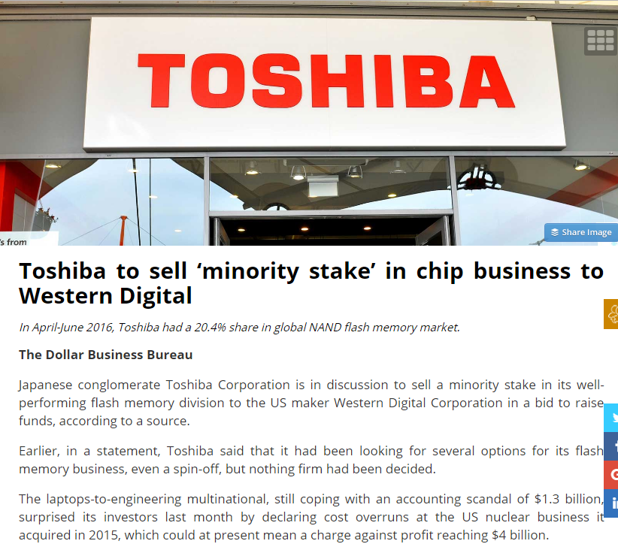
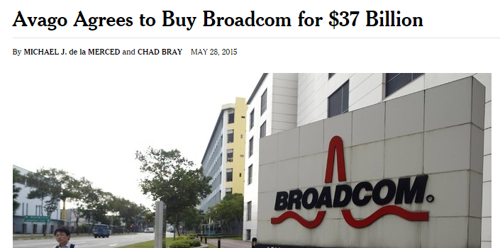
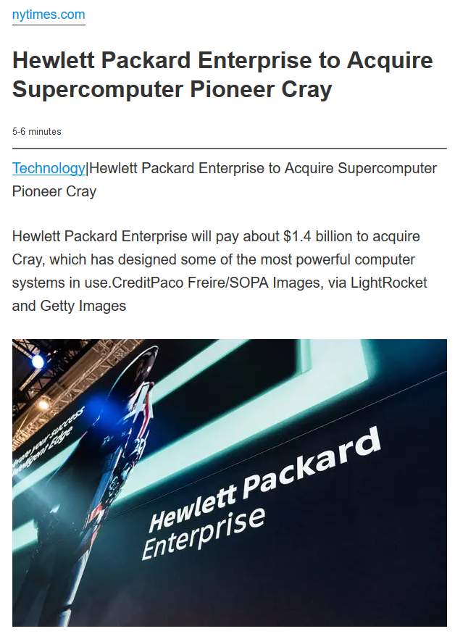
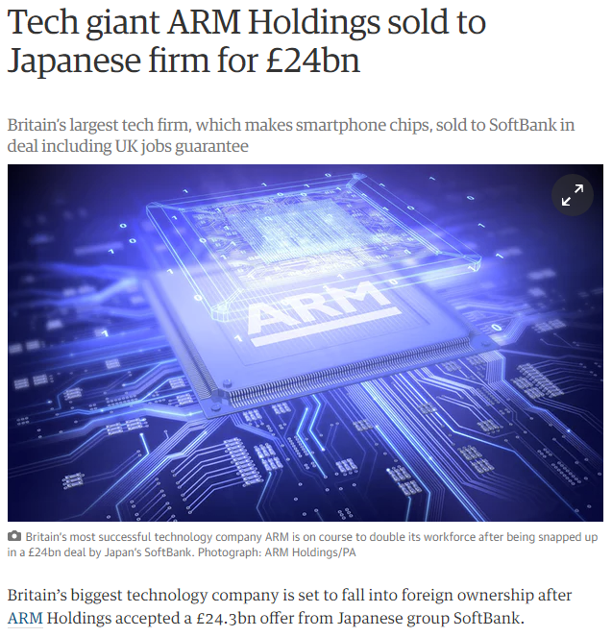
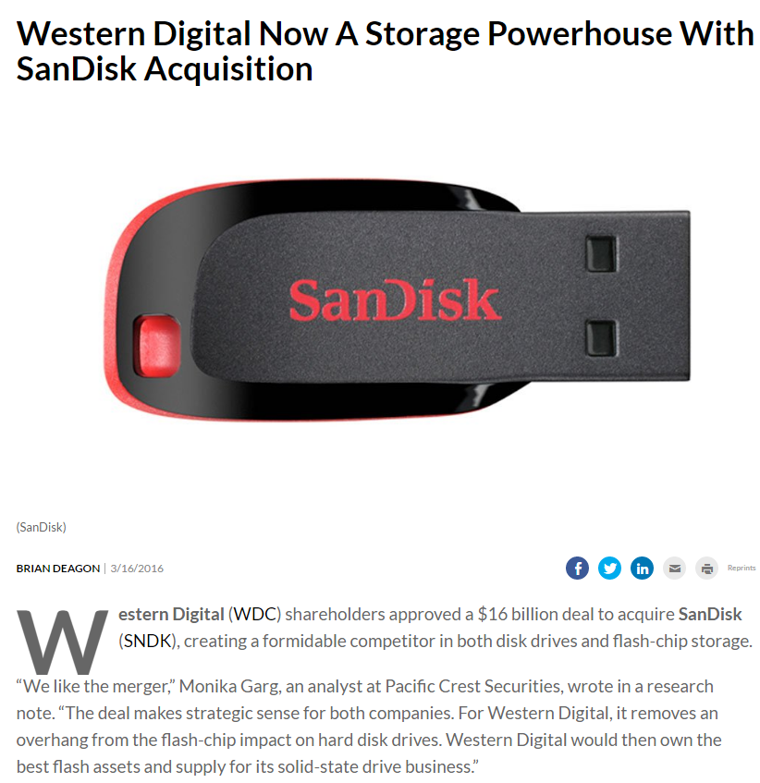
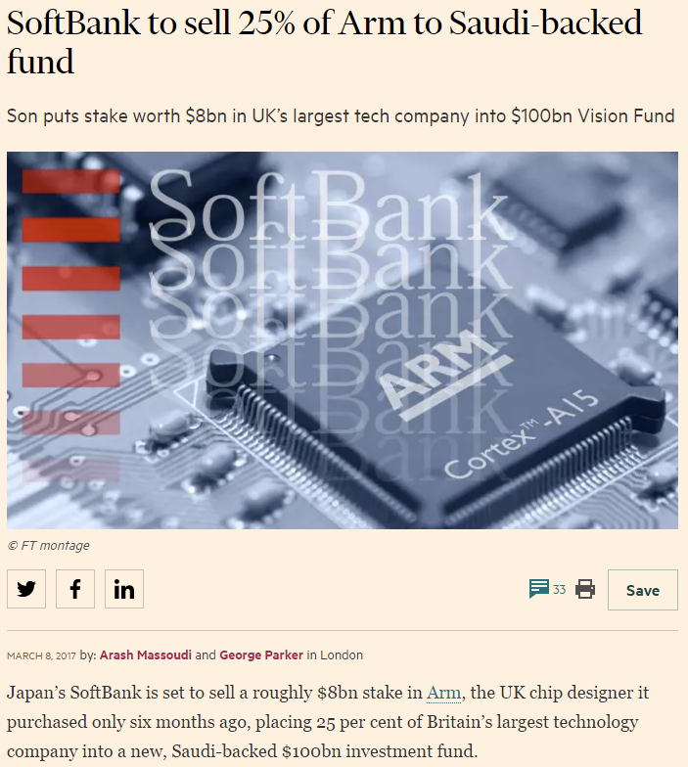
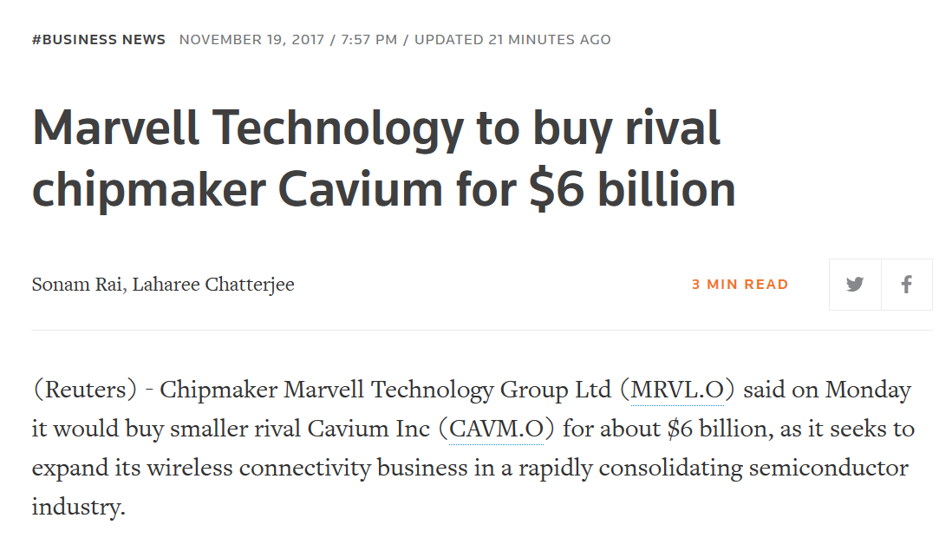
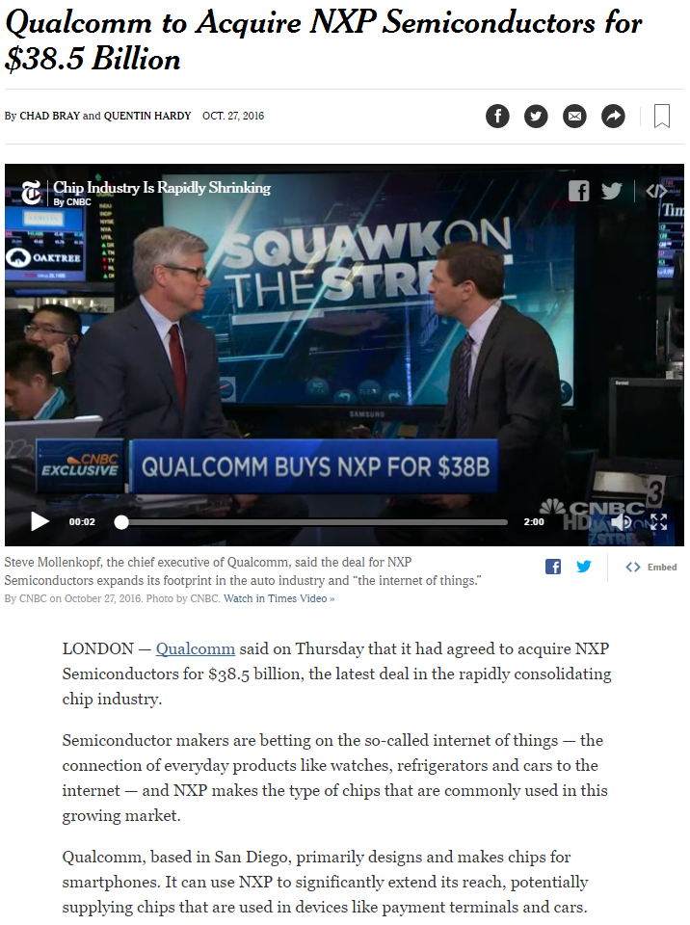
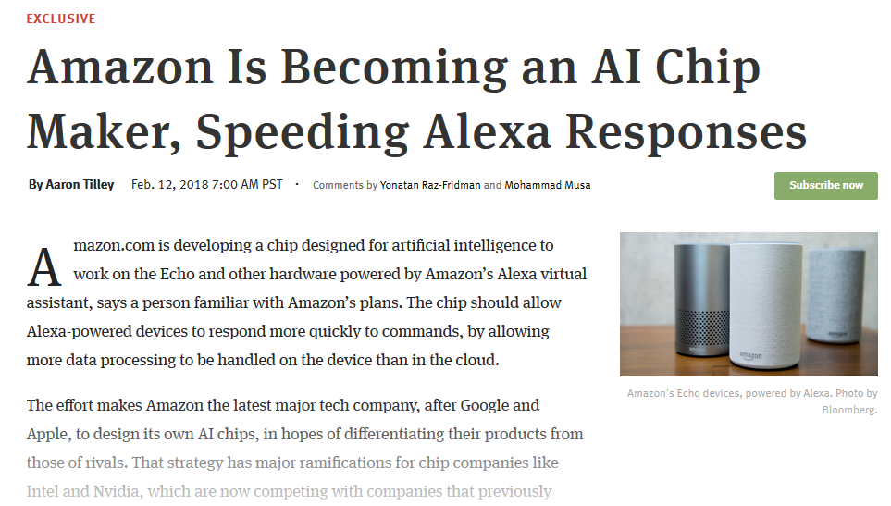
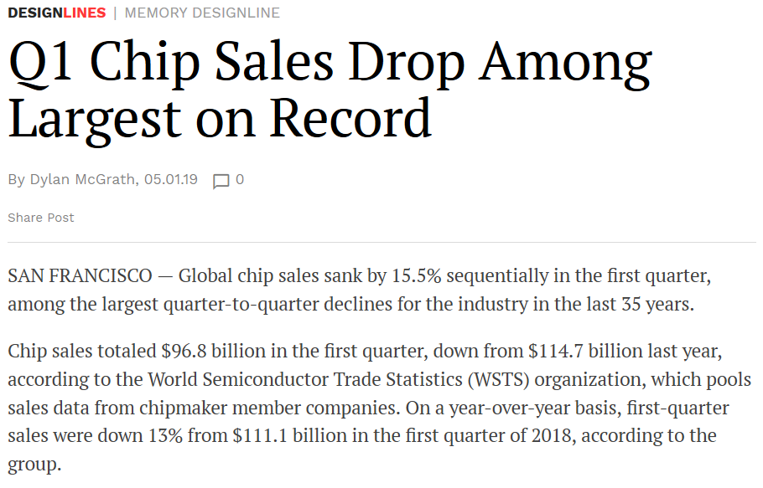
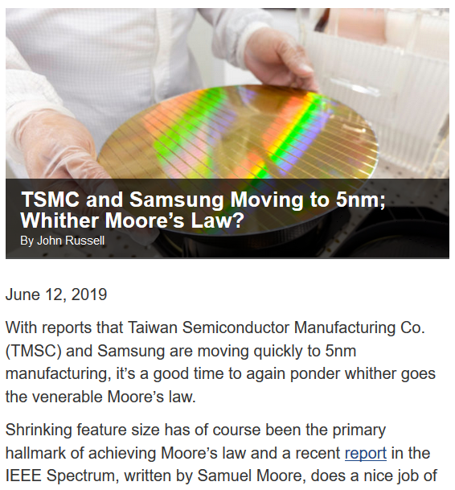
Business climate reflects this uncertainty, cost, complexity, consolidation

Slide 7
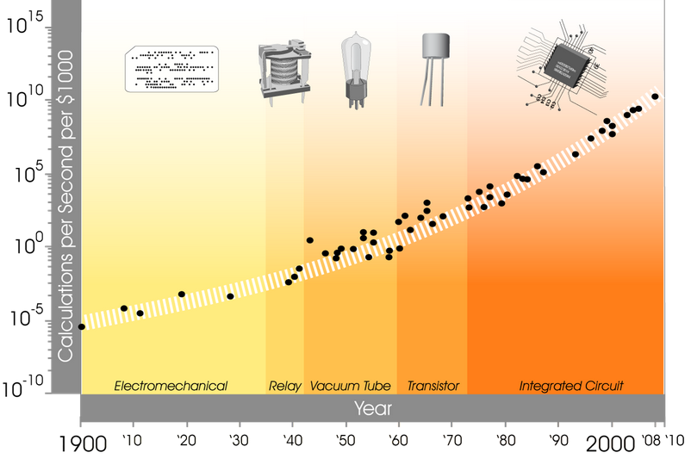
Sixth Wave of Computing
Transition Period
6th wave
http://www.kurzweilai.net/exponential-growth-of-computing

Slide 8
Predictions for Transition Period
Optimize Software and Expose New Hierarchical Parallelism
Use CMOS more effectively for specific workloads
Emerging Technologies
Investigate new computational paradigms
Quantum
Redesign software to boost performance on upcoming architectures
Neuromorphic
Advanced Digital
Architectural Specialization and Integration
Emerging Memory Devices
Integrate components to boost performance and eliminate inefficiencies
Exploit new levels of parallelism and efficient data movement
Workload specific memory+storage system design

Slide 9
Predictions for Transition Period
Optimize Software and Expose New Hierarchical Parallelism
Use CMOS more effectively for specific workloads
Emerging Technologies
Investigate new computational paradigms
Quantum
Redesign software to boost performance on upcoming architectures
Neuromorphic
Advanced Digital
Architectural Specialization and Integration
Emerging Memory Devices
Integrate components to boost performance and eliminate inefficiencies
Exploit new levels of parallelism and efficient data movement
Workload specific memory+storage system design

Slide 10
Predictions for Transition Period
Optimize Software and Expose New Hierarchical Parallelism
Use CMOS more effectively for specific workloads
Emerging Technologies
Investigate new computational paradigms
Quantum
Redesign software to boost performance on upcoming architectures
Neuromorphic
Advanced Digital
Architectural Specialization and Integration
Emerging Memory Devices
Integrate components to boost performance and eliminate inefficiencies
Exploit new levels of parallelism and efficient data movement
Workload specific memory+storage system design

Slide 11

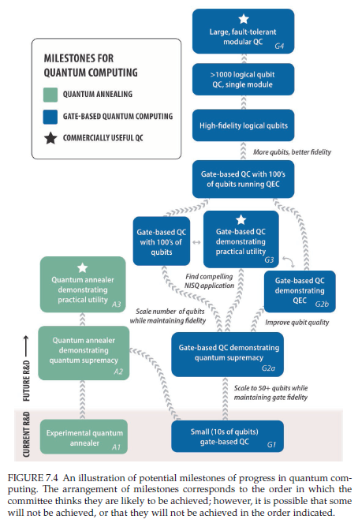
Quantum computing: Qubit design and fabrication have made recent progress but still face challenges
Science 354, 1091 (2016) – 2 December
http://nap.edu/25196

Slide 12
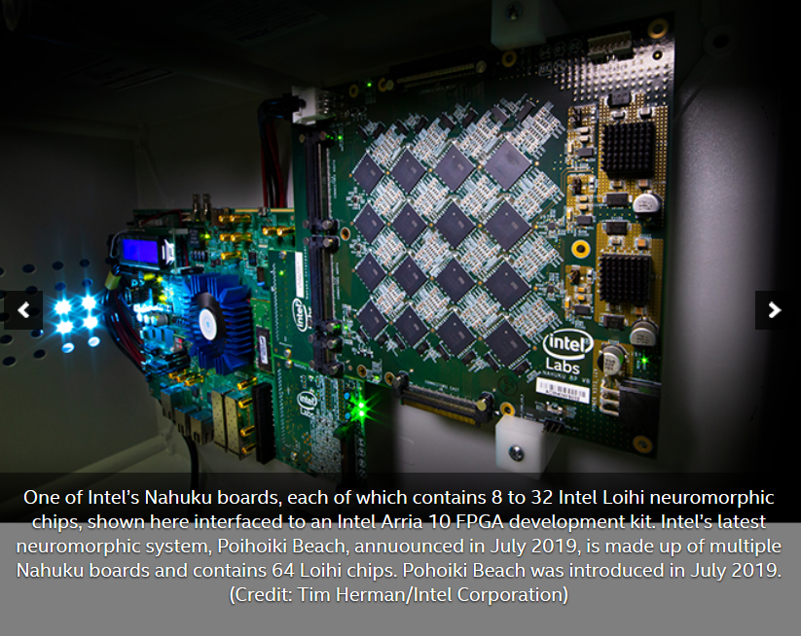
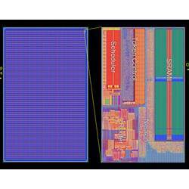
Neuromorphic (Brain Inspired) Computing
SpiNNaker
IBM True North
BrainScaleS
DANNA
Others…
https://m-cacm.acm.org/news/201072-the-future-of-microchips
https://newsroom.intel.com/news/intels-pohoiki-beach-64-chip-neuromorphic-system-delivers-breakthrough-results-research-tests/

Slide 13
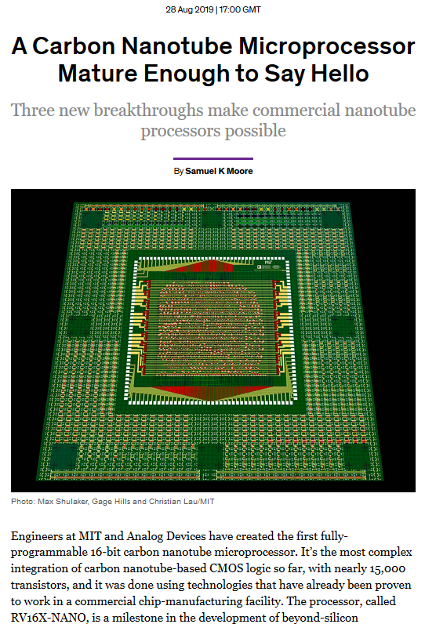
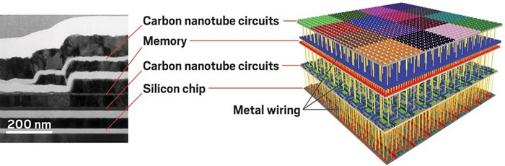
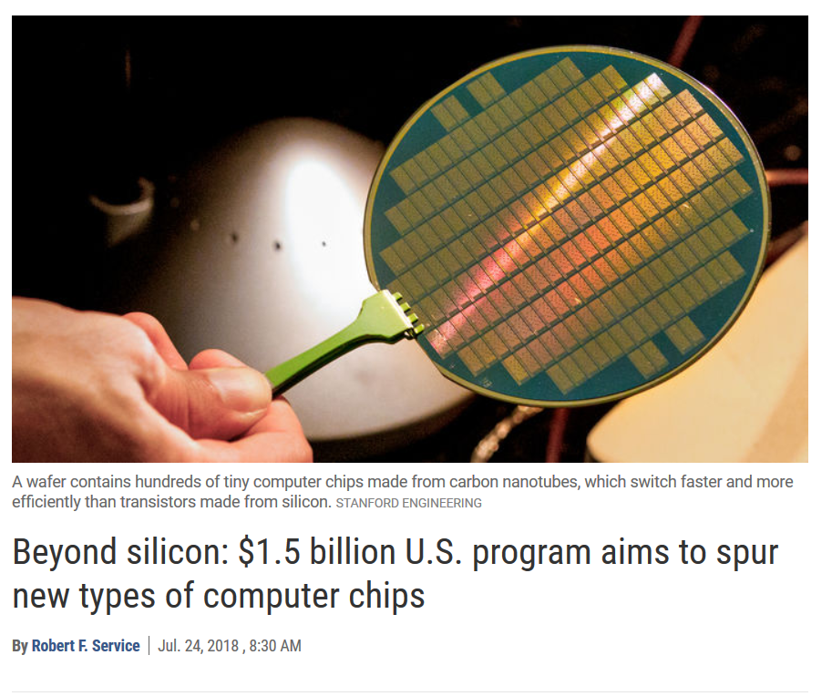
New devices: Carbon Nanotube Transistors and Circuits
https://cen.acs.org/materials/electronic-materials/Carbon-nanotube-computers-face-makebreak/97/i8
https://spectrum.ieee.org/nanoclast/semiconductors/processors/modern-microprocessor-built-using-carbon-nanotubes

Slide 14
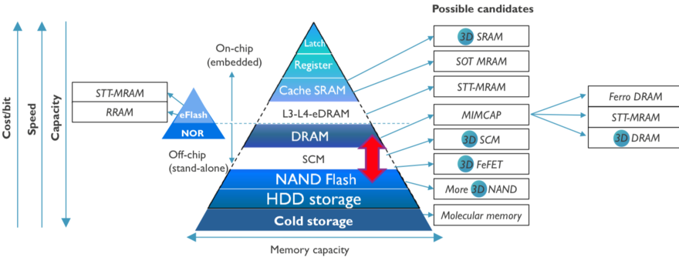
Emerging Memory Devices
Image Source: IMEC

Slide 15
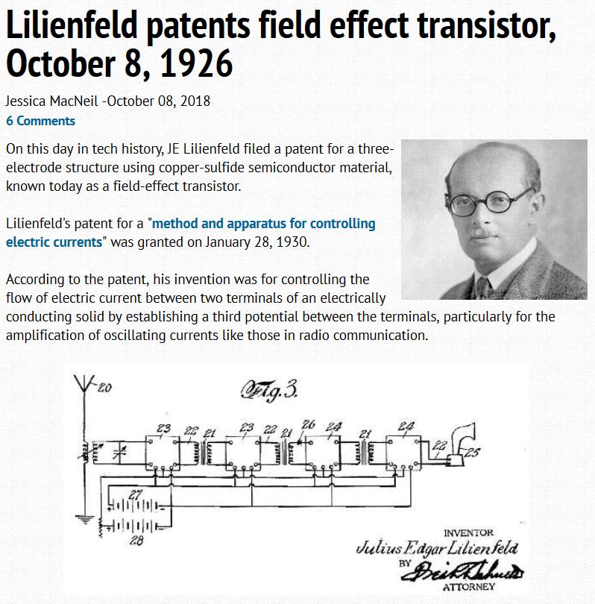
Q: when was the field effect transistor patented?
https://www.edn.com/electronics-blogs/edn-moments/4422371/Lilienfeld-patents-field-effect-transistor--October-8--1926

Slide 16
Predictions for Transition Period
Optimize Software and Expose New Hierarchical Parallelism
Use CMOS more effectively for specific workloads
Emerging Technologies
Investigate new computational paradigms
Quantum
Redesign software to boost performance on upcoming architectures
Neuromorphic
Advanced Digital
Architectural Specialization and Integration
Emerging Memory Devices
Integrate components to boost performance and eliminate inefficiencies
Exploit new levels of parallelism and efficient data movement
Workload specific memory+storage system design

Slide 17
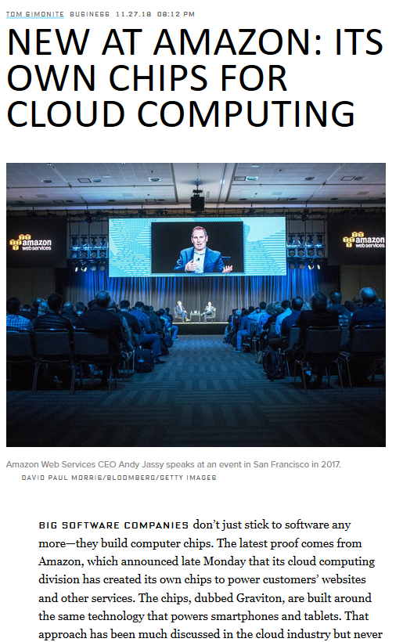
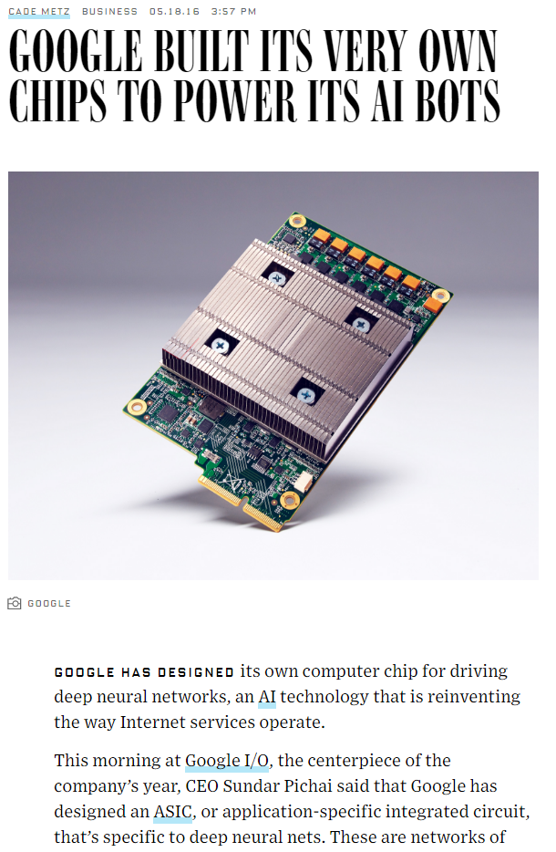
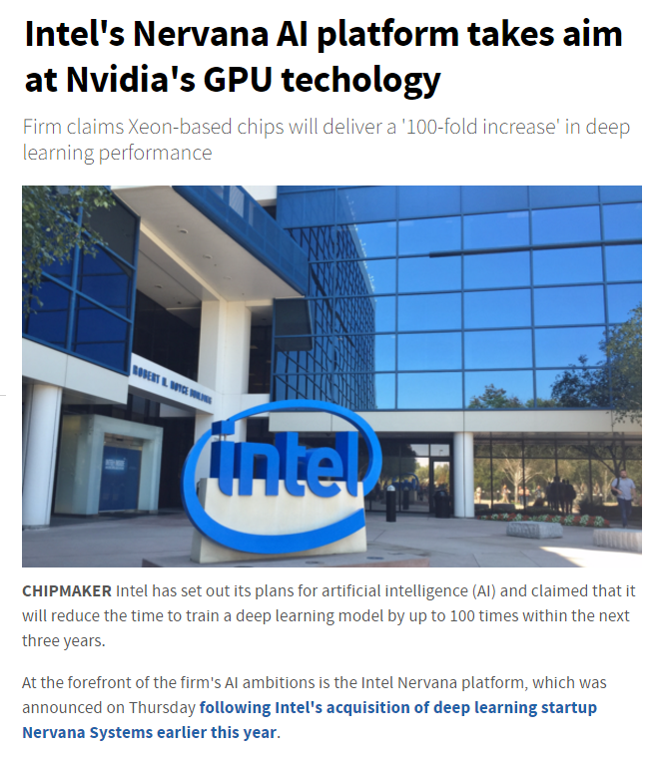
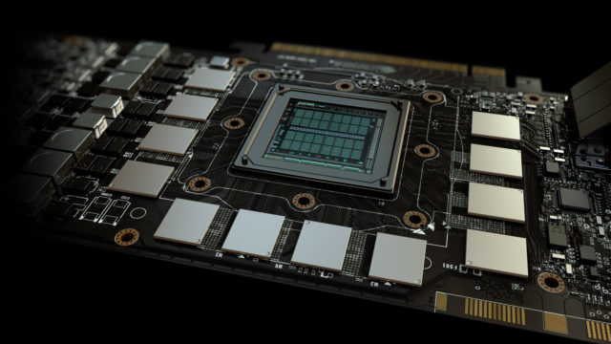
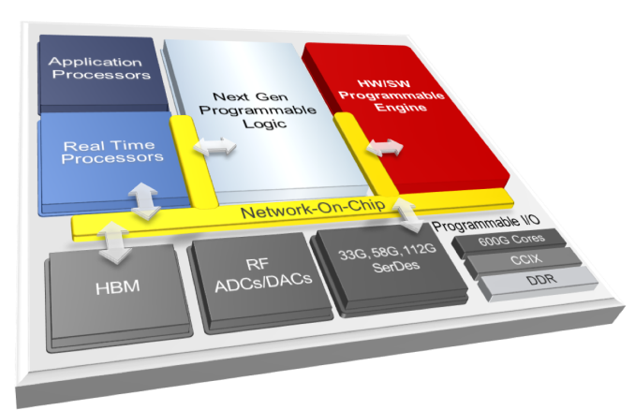
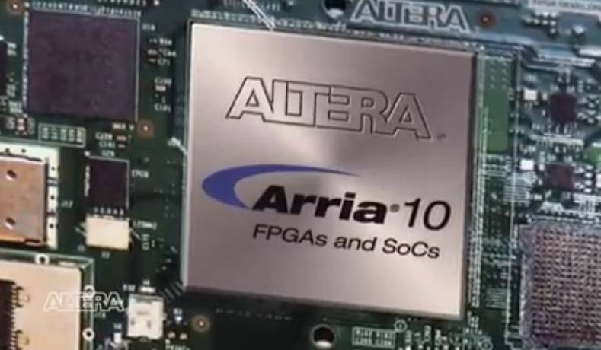
Pace of Architectural Specialization is Quickening
Industry, lacking Moore’s Law, will need to continue to differentiate products (to stay in business)
Use the same transistors differently to enhance performance
Architectural design will become extremely important, critical
Dark Silicon
Address new parameters for benefits/curse of Moore’s Law
50+ new companies focusing on hardware for Machine Learning
http://www.theinquirer.net/inquirer/news/2477796/intels-nervana-ai-platform-takes-aim-at-nvidias-gpu-techology
http://www.wired.com/2016/05/google-tpu-custom-chips/
D.E. Shaw, M.M. Deneroff, R.O. Dror et al., “Anton, a special-purpose machine for molecular dynamics simulation,” Communications of the ACM, 51(7):91-7, 2008.
https://fossbytes.com/nvidia-volta-gddr6-2018/
HotChips 2018
HotChips 2018
Xilinx ACAP
https://www.thebroadcastbridge.com/content/entry/1094/altera-announces-arria-10-2666mbps-ddr4-memory-fpga-interface

Slide 18
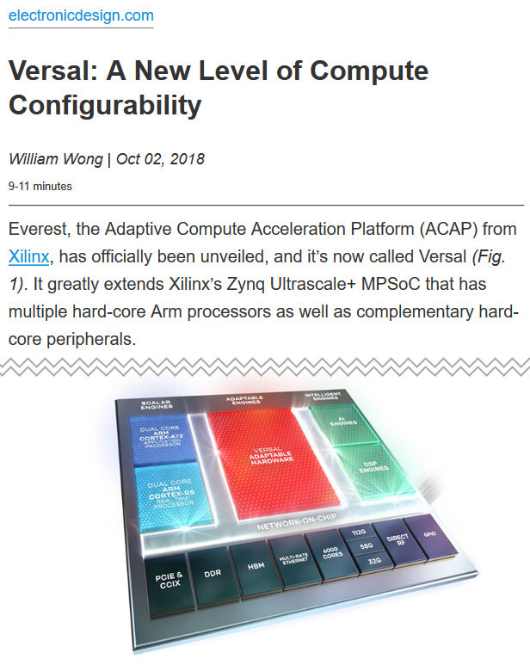
Future hardware will be far more diverse and mercurial than recent history (HotChips 2018)

Slide 19
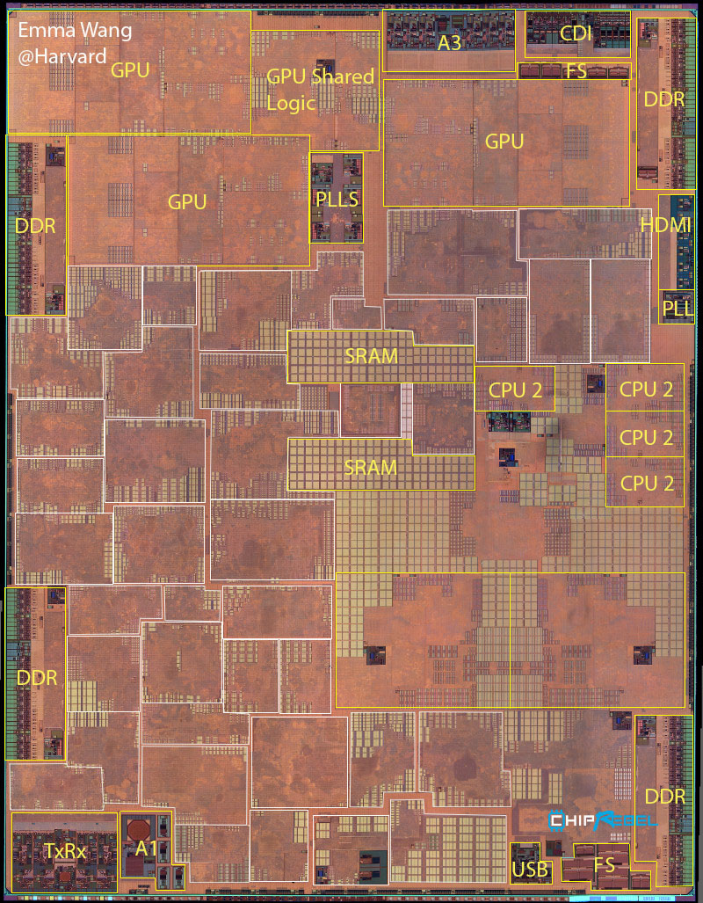
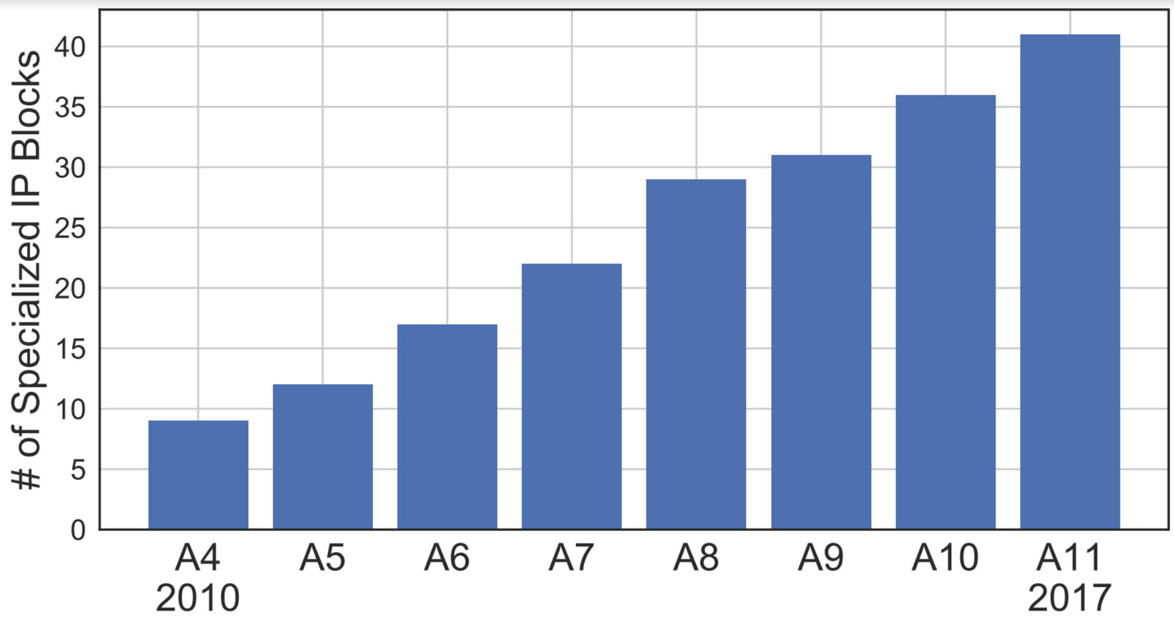
Analysis of Apple A-* SoCs
http://vlsiarch.eecs.harvard.edu/accelerators/die-photo-analysis

Slide 20
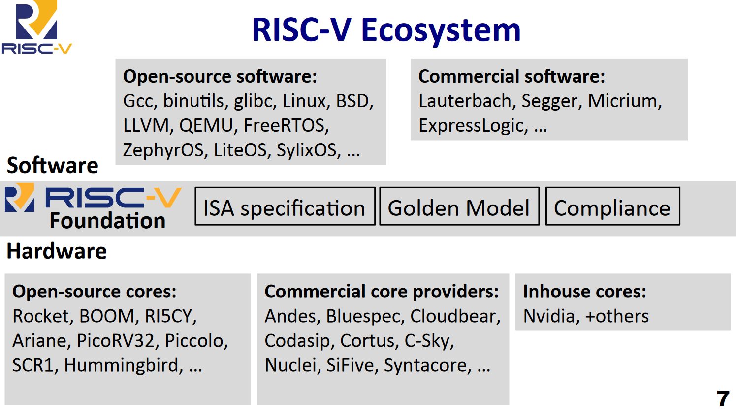
Growing Open Source Hardware Movement Enables Rapid Chip Design
RISC-V Summit, 2018

Slide 21
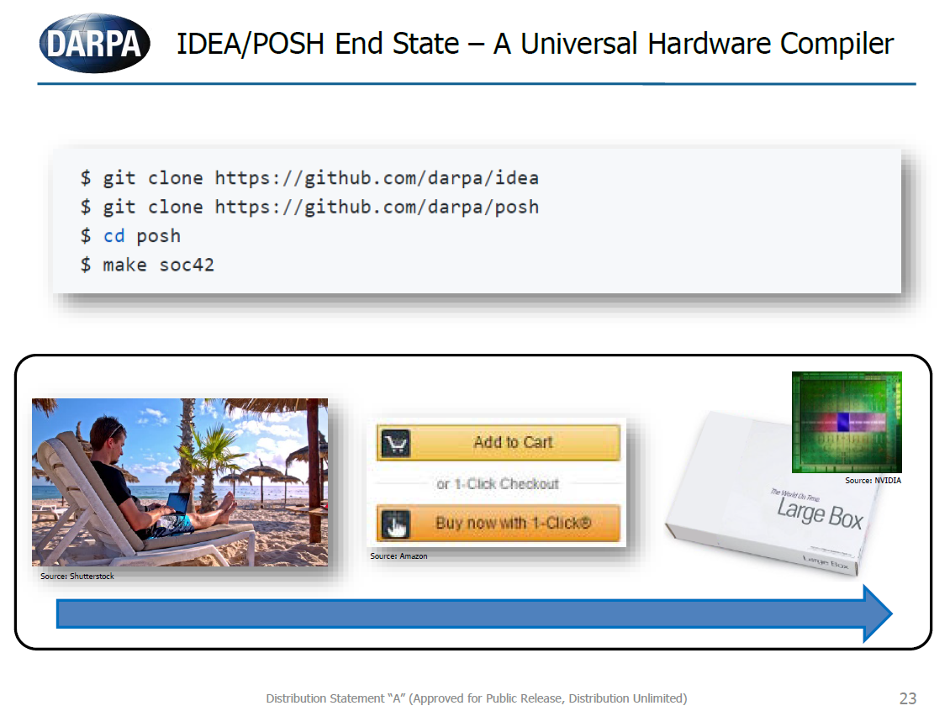
DARPA ERI Programs Aiming for Agile (and Frequent) Chip Creation
A. Olofsson, 2018

Slide 22
Summary: Transition Period will be Disruptive – Opportunities and Pitfalls Abound
New devices and architectures may not be hidden in traditional levels of abstraction
Examples
A new type of CNT transistor may be completely hidden from higher levels
A new paradigm like quantum may require new architectures, programming models, and algorithmic approaches
Adapted from IEEE Rebooting Computing Chart

Slide 23
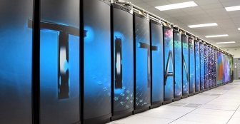
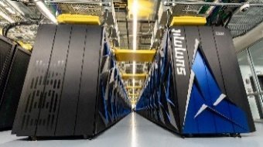

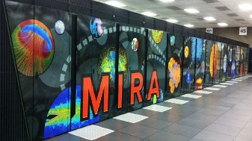
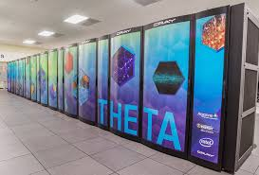
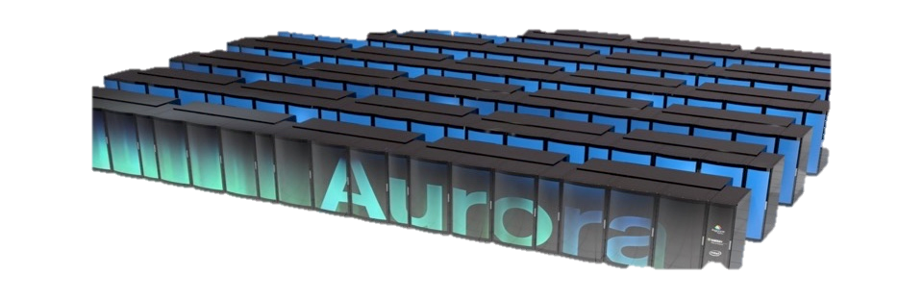
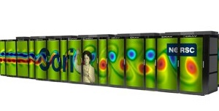
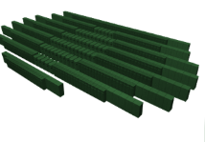
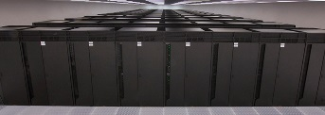
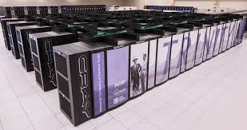
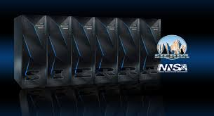


Department of Energy (DOE) Roadmap to Exascale Systems An impressive, productive lineup of accelerated node systems supporting DOE’s mission
Pre-Exascale Systems [Aggregate Linpack (Rmax) = 323 PF!]
First U.S. Exascale Systems
2012
2016
2018
2020
2021-2023
Titan (9)
Heterogeneous Cores
Summit (1)
ORNL
AMD/Cray
ORNL
Cray/AMD/NVIDIA
ORNL
IBM/NVIDIA
Deep Memory incl NVM
Aurora
Mira (21)
Theta (24)
ANL
Intel/Cray
ANL
IBM BG/Q
ANL
Cray/Intel KNL
Cori (12)
NERSC-9
Perlmutter
Plateauing I/O Performance
LBNL
Cray/Intel Xeon/KNL
LBNL
Cray/AMD/NVIDIA
Sequoia (10)
LLNL
TBD
Trinity (6)
Sierra (2)
LLNL
IBM BG/Q
LLNL
IBM/NVIDIA
LANL/SNL
Cray/Intel Xeon/KNL
LANL/SNL
TBD
Jan 2018
Notes:
Current pre-exascale systems (Rmax): 6.92 + 8.59 + 14.01 + 17.17 + 17.59 + 20.16 + 94.64 + 143.5

Slide 24



Slide 25



Frontier: The OLCF 2021 Exascale computer
Advanced simulations
High- performance data analytics
Artificial intelligence
2021 delivery planned with >1000 PF performance (50–100× the scientific productivity of current Titan system)
Design review
Award contract
Solicit bids for
computer build
Frontier NRE: hardware and software engineering
Prepare power, cooling, and space
Installation
Prepare scientific software applications
Frontier available
Summit available: 200 PF production system
Titan available: 27 PF
CY 2017
CY 2018
CY 2019
CY 2020
CY 2021
CY 2022
CY 2023
http://procurement.ornl.gov/rfp/CORAL2/

Slide 26


Frontier | 7 May 2019

Slide 27














Final Report on Workshop on Extreme Heterogeneity
Maintaining and improving programmer productivity
Flexible, expressive, programming models and languages
Intelligent, domain-aware compilers and tools
Composition of disparate software components
Managing resources intelligently
Automated methods using introspection and machine learning
Optimize for performance, energy efficiency, and availability
Modeling & predicting performance
Evaluate impact of potential system designs and application mappings
Model-automated optimization of applications
Enabling reproducible science despite non-determinism & asynchrony
Methods for validation on non-deterministic architectures
Detection and mitigation of pervasive faults and errors
Facilitating Data Management, Analytics, and Workflows
Mapping of science workflows to heterogeneous hardware and software services
Adapting workflows and services to meet facility-level objectives through learning approaches
https://orau.gov/exheterogeneity2018/
https://doi.org/10.2172/1473756

Slide 28

The Summit System @ ORNL #1 on Top 500 since June 2018
System Performance
The system includes
Each node has
Peak of 200 Petaflops (FP₆₄) for modeling & simulation
Peak of 3.3 ExaOps (FP₁₆) for data analytics and artificial intelligence
Max power 13 MW
4,608 nodes
Dual-rail Mellanox EDR InfiniBand network
250 PB IBM file system transferring data at 2.5 TB/s
2 IBM POWER9 processors
6 NVIDIA Tesla V100 GPUs
608 GB of fast memory
(96 GB HBM2 + 512 GB DDR4)
1.6 TB of NV memory

Slide 29



NVIDIA’s tesla v100
5,120 CUDA cores (64 on each of 80 SMs)
640 NEW Tensor cores (8 on each of 80 SMs)
20MB SM RF | 16MB Cache | 16GB HBM2 @ 900 GB/s
300 GB/s NVLink
7.5 FP64 TFLOPS | 15 FP32 TFLOPS | 120 Tensor TFLOPS
>27K of these on ORNL’s Summit system!
Mixed precision matrix math 4x4 matrices
The M&S community must figure how out to “cheat” and utilize mixed / reduced precisions
Ex: Jack Dongarra shows he can get 4x FP64 peak for 64bit LU on V100 with iterative mixed precision (using GMRES!)

Slide 30
Frontier | 7 May 2019

Slide 31
Department of Energy (DOE) Roadmap to Exascale Systems An impressive, productive lineup of accelerated node systems supporting DOE’s mission
Pre-Exascale Systems [Aggregate Linpack (Rmax) = 323 PF!]
First U.S. Exascale Systems
2012
2016
2018
2020
2021-2023
Titan (9)
Heterogeneous Cores
Summit (1)
ORNL
AMD/Cray
ORNL
Cray/AMD/NVIDIA
ORNL
IBM/NVIDIA
Deep Memory incl NVM
Aurora
Mira (21)
Theta (24)
ANL
Intel/Cray
ANL
IBM BG/Q
ANL
Cray/Intel KNL
Cori (12)
NERSC-9
Perlmutter
Plateauing I/O Performance
LBNL
Cray/Intel Xeon/KNL
LBNL
Cray/AMD/NVIDIA
Sequoia (10)
LLNL
TBD
Trinity (6)
Sierra (2)
LLNL
IBM BG/Q
LLNL
IBM/NVIDIA
LANL/SNL
Cray/Intel Xeon/KNL
LANL/SNL
TBD
Jan 2018
Notes:
Current pre-exascale systems (Rmax): 6.92 + 8.59 + 14.01 + 17.17 + 17.59 + 20.16 + 94.64 + 143.5

Slide 32
ORNL Cosmic Castle: Codesign for DSSoC Processors PY1.Q4 Review
Jeffrey S. Vetter
Seyong Lee
Mehmet Belviranli
Roberto Gioiosa
Richard Glassbrook
DARPA ERI DSSoC PY1Q4 Program Review
ORNL
17 Jul 2019
DARPA ERI DSSoC Program: Dr. Tom Rondeau
17 Jul 2019

Slide 33
DARPA Domain-Specific System on a Chip (DSSoC) Program
DARPA ERI DSSoC Program: Dr. Tom Rondeau

Slide 34













The history of GNU Radio inspiring the key technical areas of DSSoC
Intelligent Scheduling Domain Representation MAC Software
Single core, single thread (Pentium 4)
2013
Embedded computing (Arm and Xilinx)
Introduction of VOLK
2001
libvolk.org/
commons.wikimedia.org
www.mccdaq.com
2014
Porting to other SoCs
(TI Keystone II)
Growing with technology (Pentium D)
processors.wiki.ti.com
2004
www.ti.com
commons.wikimedia.org
media.wired.com
2015
Porting to the smart phone (Android devices)
2008
Multi-threaded scheduling (Cell Broadband Engine)
Processors
Computer
I/O
commons.wikimedia.org
USB 2.0
USB 3.0
Thunderbolt2
1 GigE
10 GigE
PCIe x4
Server farms
Workstations
Laptops
Smart Phones
Embedded Systems
Today
Intel
Arm
PowerPC
2008
Moving to multi-core processors (i7)
www.ettus.com
commons.wikimedia.org
Distribution Statement “A” (Approved for Public Release, Distribution Unlimited)
Slide courtesy of Dr. Tom Rondeau, DARPA MTO

Slide 35

Getting the best out of specialization when we need programmability
Three Optimization Areas
Design time
Run time
Compile time
DSSoC’s Full-Stack Integration
Development Environment and Programming Languages
Decoupled Software development
Application
Libraries
Addressed via five program areas
Intelligent scheduling
Domain representations
Software
Medium access control (MAC)
Hardware integration
Operating System
Compiler, linker, assembler
Heterogeneous architecture composed of Processor Elements:
CPUs
Graphics processing units
Tensor product units
Neuromorphic units
Accelerators (e.g., FFT)
DSPs
Programmable logic
Math accelerators
Integrated performance analysis
Hardware-Software Co-design
Medium Access Control
Intelligent scheduling/routing
Looking at how Hardware/Software co-design is an enabler for efficient use of processing power
Distribution Statement “A” (Approved for Public Release, Distribution Unlimited)
Slide courtesy of Dr. Tom Rondeau, DARPA MTO

Slide 36


Domain-Specific System on Chip (DSSoC)
Optimized to run a single application
Simultaneously run multiple applications
Programmed with different toolchains
Too general or application-specific
Intelligent tools to aid programmers
Domain-driven selection and layout
We cannot fully utilize our current multi-processor systems
We want to manage an increase of capabilities with integrated specialized accelerators
Distribution Statement “A” (Approved for Public Release, Distribution Unlimited)
Slide courtesy of Dr. Tom Rondeau, DARPA MTO

Slide 37







DSSoC: Domain-driven design
Domain corpus
Literature, published text, code
Applications
e.g. GMTI, SAR, ESM
Ontology Generator
Compiler
Intermediate
Representation
(IR)
Domain ontology discovery
Development tools
(compilers, debuggers, performance analysis)
Performance monitor tools
38%
41%
3%
Percentage of ontology
CPU
CPU
CPU
Program Results
GPU
GPU
GPU
Acc
Acc
Acc
Intelligent
Scheduler
Performance counters
Workload mix
Design Space
Design: Processor Element selection and affinity analysis
DSSoC
Design constraints
Distribution Statement “A” (Approved for Public Release, Distribution Unlimited)
Slide courtesy of Dr. Tom Rondeau, DARPA MTO

Slide 38






Domain Specific System on Chip (DSSoC) Program to address these challenges Performer domains and applications
IBM T. J. Watson Research Center Pradip Bose
Columbia University, Harvard University, Univ. of Illinois at Urbana-Champaign
CV+SDR
Multi-domain application
Multi-spectral processing
Communications
Arizona State University
Daniel W. Bliss
Univ. of Michigan, Carnegie Mellon University, General Dynamic Mission Systems, Arm Ltd., EpiSys Science
SDR
Unmanned aerial
Small robotic & leave-behind
Universal soldier systems
Multifunction systems
Raytheon/Xilinx
Tom Kazior
SDR
Xilinx ACAP
Visual system integrator
Improved reconfigurability of processing systems
PlastyForma
IBM
Stanford University
Mark Horowitz
Clark Barrett, Kayvon Fatahalian, Pat Hanrahan, Priyanka Raina
Computer Vision
Still image and video processing
Autonomous navigation
Continuous surveillance
Augmented reality
Oak Ridge National Laboratory
Jeffrey Vetter
SDR
Communications and signal processing focused
Up-front processing / data cutdown
Improving understanding of processing systems
Raytheon
Stanford
Google/YouTube
ORNL
Distribution Statement “A” (Approved for Public Release, Distribution Unlimited)
Slide courtesy of Dr. Tom Rondeau, DARPA MTO

Slide 39
ORNL Cosmic Castle
Contract Number: HR001117S0055--FP-008
Submission Date: Dec 2017
Review period: Feb 2019 – July 2019
Technical POC: Jeffrey S. Vetter, vetter@computer.org
Administrative POC: Richard Glassbrook, glassbrook@computer.org
Summary: Enabling codesign of DSSoC processors and software for mission-critical applications
Jeffrey Vetter, PI
Roberto Gioiosa, Runtime Systems
Mehmet Belviranli, Apps, Modeling, Ontologies
Seyong Lee, Programming Systems
Richard Glassbrook, Project Manager
Mohammad Monil, Intern, Oregon
Abdel-Kareem Moadi, Software/Hardware Engineer
Steve Moulton, Systems Engineer
Blaise Tine, Intern, Georgia Tech

Slide 40
ORNL Cosmic Project
Jeffrey S. Vetter
Seyong Lee
Mehmet Belviranli
Roberto Gioiosa
Richard Glassbrook
Abdel-Kareem Moadi

Slide 41
ORNL Cosmic Project

Slide 42
Cosmic Castle | Development Lifecycle
Precise configuration and benchmark data for static analysis, mapping, partitioning, code generation, etc
Dynamic Performance Feedback including profiling and configuration response
Applications
Create scalable application Aspen models manually, with static or dynamic analysis, or using historical information
Ontologies
Ontologies based on Aspen models using statistical and machine learning techniques
Programming systems
Programming systems built to support ontologies
Runtime and Scheduling
DSSoC Chip
Query Aspen models and PFU for automatic code generation, optimization, etc.
Intelligent runtime scheduling uses models and PFU to inform dynamic decisions
DSSoC design quantitatively derived from application Aspen models
As feature of DSSoC, PFU API provides dynamic performance response of deployed DSSoC to intelligent runtime and programming system.
Performance Functional API
Dynamic resource discovery and monitoring
Early design space exploration with Aspen
DSSoC Design
DSSoC design quantitatively derived from application Aspen models
Early design space exploration with Aspen

Slide 43

Cosmic Castle | Project Overview

Slide 44
Project Overview

Slide 45
Hardware

Slide 46
Cosmic Castle | Project Overview

Slide 47





Slide 48


Intel Stratix 10 FPGA available Experimental Computing Lab (ExCL) managed by the ORNL Future Technologies Group
https://excl.ornl.gov/
Intel Stratix 10 FPGA and four banks of DDR4 external memory
Board configuration: Nallatech 520 Network Acceleration Card
Up to 10 TFLOPS of peak single precision performance
25MBytes of L1 cache @ up to 94 TBytes/s peak bandwidth
2X Core performance gains over Arria® 10
Quartus and OpenCL software (Intel SDK v18.1) for using FPGA
Provide researcher access to advanced FPGA/SOC environment
For more information or to apply for an account, visit https://excl.ornl.gov/
Mar 2019
Notes:
Image source
https://www.intel.com/content/www/us/en/programmable/products/boards_and_kits/dev-kits/altera/kit-s10-fpga.html
https://www.nallatech.com/

Slide 49
NVIDIA Jetson AGX Xavier SoC available Experimental Computing Lab (ExCL) managed by the ORNL Future Technologies Group
https://excl.ornl.gov/
NVIDIA Jetson AGX Xavier:
High-performance system on a chip for autonomous machines
Heterogeneous SoC contains:
Eight-core 64-bit ARMv8.2 CPU cluster (Carmel)
1.4 CUDA TFLOPS (FP32) GPU with additional inference optimizations (Volta)
11.4 DL TOPS (INT8) Deep learning accelerator (NVDLA)
1.7 CV TOPS (INT8) 7-slot VLIW dual-processor Vision accelerator (PVA)
A set of multimedia accelerators (stereo, LDC, optical flow)
Provides researchers access to advanced high-performance SOC environment
For more information or to apply for an account, visit https://excl.ornl.gov/
Mar 2019
Notes:
Image source
https://www.intel.com/content/www/us/en/programmable/products/boards_and_kits/dev-kits/altera/kit-s10-fpga.html
https://www.nallatech.com/

Slide 50




Qualcomm 855 SoC (SM8510P) Experimental Computing Lab (ExCL) managed by the ORNL Future Technologies Group
https://excl.ornl.gov/
Qualcomm Development Board connected to (mcmurdo) HPZ820
Adreno 640
7nm TSMC
Hexagon 690
5G
Spectra 360
Kyro 485
© Qualcomm Inc.
© Qualcomm Inc.
Kyro 485 (8-ARM Prime+BigLittle Cores)
Connectivity (5G)
Snapdragon X24 LTE (855 built-in) modem LTE Category 20
Snapdragon X50 5G (external) modem (for 5G devices)
Qualcomm Wi-Fi 6-ready mobile platform: (802.11ax-ready, 802.11ac Wave 2, 802.11ay, 802.11ad)
Qualcomm 60 GHz Wi-Fi mobile platform: (802.11ay, 802.11ad)
Bluetooth Version: 5.0
Bluetooth Speed: 2 Mbps
High accuracy location with dual-frequency GNSS.
Connected Qualcomm board to HPZ820 through USB
Development Environment: Android SDK/NDK
Login to mcmurdo machine
$ ssh –Y mcmurdo
Setup Android platform tools and development environment
$ source /home/nqx/setup_android.source
Run Hello-world on ARM cores
$ git clone https://code.ornl.gov/nqx/helloworld-android
$ make compile push run
Run OpenCL example on GPU
$ git clone https://code.ornl.gov/nqx/opencl-img-processing
Run Sobel edge detection
$ make compile push run fetch
Login to Qualcomm development board shell
$ adb shell
$ cd /data/local/tmp
Prime
Core
Hexagon 690 (DSP + AI)
Quad threaded Scalar Core
DSP + 4 Hexagon Vector Xccelerators
New Tensor Xccelerator for AI
Apps: AI, Voice Assistance, AV codecs
Adreno 640
Spectra 360 ISP
Vulkan, OpenCL, OpenGL ES 3.1
Apps: HDR10+, HEVC, Dolby, etc
Enables 8k-360º VR video playback
20% faster compared to Adreno 630
New dedicated Image Signal Processor (ISP)
Dual 14-bit CV-ISPs; 48MP @ 30fps single camera
Hardware CV for object detection, tracking, streo depth process
6DoF XR Body tracking, H265, 4K60 HDR video capture, etc.
For more information or to apply for an account, visit https://excl.ornl.gov/
Created by Narasinga Rao Miniskar, Steve Moulton

Slide 51
RISC-V

Slide 52
Applications

Slide 53
Applications

Slide 54



End-to-End System: Gnu Radio for Wifi on two NVIDIA Xavier SoCs
Xavier SoC
Xavier SoC
UDP
Video/Image Files
Antenna
GNR IEEE-802.11 Transmit (TX)
IEEE-802.11 Receive (RX)
UDP
Signal processing: An open-source implementation of IEEE-802.11 WIFI a/b/g with GNR OOT modules.
Input / Output file support via Socket PDU (UDP server) blocks
Image/Video transcoding with OpenCL/OpenCV

Slide 55
Applications Profiling
Preliminary SDR Application Profiling:
Created fully automated GRC profiling toolkit
Ran each of the 89 flowgraph for 30 seconds
Profiled with performance counters
Major overheads:
Python glue code (libpython), O/S threading & profiling (kernel.kallsysms, libpthread), libc, ld, Qt
Runtime overhead:
Will require significant consideration when run on SoC
Cannot be executed in parallel
Hardware assisted scheduling is essential
Library | Percentage
[kernel.kallsyms] | 27.8547
libpython | 18.6281
libgnuradio | 11.7548
libc | 7.7503
ld | 3.8839
libvolk | 3.7963
libperl | 3.7837
[unknown] | 3.6465
libQt5 | 2.9866
libpthread | 2.1449

Slide 56

GNR-Tools
GNR-Tools
PY1Q2: Three tools are released
Block-level Ontologies [ontologyAnalysis]
Following properties are extracted from a batch of block definition files: Descriptions and IDs, source and sink ports (whether input/output is scalar, vector or multi-port), allowed data types, and additional algorithm-specific parameters
Flowgraph Characterization [workflowAnalysis]
Characterization of GNR workloads at the flowgraph level.
Scripts automatically run for for 30 seconds and reports a breakdown of high-level library module calls
Design-space Exploration [designSpaceCL]
Script to run 13 blocks included in gr-clenabled - Both on a GPU and on a single CPU core - By using input sizes varying between 24 and 227 elements.
PY1Q3: Two more tools are added
cgran-scraper
GRC-analyzer
https://code.ornl.gov/fub/gnr-tools

Slide 57

New GNR-tools: cgran scraper and GRC statistics
cgran-scraper
Scans all repos in cgran
Automatically clones all repos
Extracts all GRC files embedded within repos (currently xml formatted GRCs only)
GRC-analyzer
Extracts two levels of static ontology information from a collection of GRC files
Usage frequencies
Block proximity graph
Usage:
Example:
analyzeGRCXmls.py --grcFolder allGRCs --blockFilters sink source gui options note parameter variable import --mode proximityGraph

Slide 58



GRC statistics: Block Usage Frequencies from CGRAN
Block usage frequencies
127 repositories, 641 GRC files
--mode usageFreq
Excluded filters: sink source gui options note parameter variable import pyqt
Duplicate occurrences of a block in a file removed
Highest 20 occurrences
Lowest 20 occurrences

Slide 59


GRC statistics: Block Proximity Analysis
Block proximity analysis
Creates a graph:
Nodes: Unique block types
Edges: Blocks used in the same GRC file.
Every co-occurrence increases edge weight by 1.
This example was run
With --mode proximityGraph
On randomly selected sub-set of GRC files

Slide 60



GRC statistics: Block Proximity Analysis
Produces a GraphViz formatted dot file
Can be visualized interactively by many open source tools
GEPHI: An open source tool that provides interactive layout & visualization
Nodes are sized by degrees
Edge weight determines thickness
Selecting a node highlights co-occurrences
[Future] More analysis options:
Nodes can be sized by frequencies
Interactions can be filtered by GRCs
Incorporate dynamic parameters

Slide 61
Performance Modeling

Slide 62
Integrating Modeling Across the Stack with Aspen

Slide 63





Aspen: Abstract Scalable Performance Engineering Notation
Model Creation
Static analysis via compiler, tools
Empirical, Historical
Manual (for future applications)
Model Uses
Interactive tools for graphs, queries
Design space exploration
Workload Generation
Feedback to Runtime Systems
Representation in Aspen
Modular
Sharable
Composable
Reflects prog structure
Source code
E.g., MD, UHPC CP 1, Lulesh,
3D FFT, CoMD, VPFFT, …
Aspen code
K. Spafford, et al, “Aspen: A Domain Specific Language for Performance Modeling,” in Proc. SC12.

Slide 64

GNURadio Flowgraph to Aspen Application Model Conversion
model demod-uhd-sync{
import uhd from "gr-uhd.aspen"
import blocks from "gr-blocks.aspen"
import digital from "gr-digital.aspen"
kernel main {
call uhd.usrp_source()
call blocks.multiply_const_vxx()
call digital.fll_band_edge_cc()
call digital.correlate_and_sync_cc()
parallel {
sequence{
parallel {
call blocks.complex_to_mag()
call blocks.complex_to_float()
}
call blocks_file_sink()
}
sequence{
call digital.pfb_clock_syc_xxx()
call digital.costas_loop_cc()
parallel {
call blocks.file_sink()
call blocks.file_sink()
}
}
}
}
}
model blocks {
kernel complex_to_mag {
param aspen_param_default = 1
param aspen_param_sizeof_float = 4
param noutput_items = 8192
param aspen_param_sizeof_FComplex = 8
execute [noutput_items] "block_clComplexToMag_kernel4"
flops [1] as integer
execute "block_clComplexToMag_kernel4__intracommIN"
intracomm [(aspen_param_sizeof_FComplex*noutput_items)] as copyin
map [noutput_items] "mapblock_clComplexToMag_kernel4"
execute "block_clComplexToMag_kernel7" {
loads [(1*aspen_param_sizeof_FComplex)] as stride(1)
loads [(1*aspen_param_sizeof_FComplex)] as stride(1)
stores [(1*aspen_param_sizeof_float)] as stride(1)
flops [4] as dp, simd
}
execute "block_clComplexToMag_kernel4__intracommOUT"
intracomm [(aspen_param_sizeof_float*noutput_items)] as copyout
}
kernel complex_to_float {...}
...
}
demod-uhd-sync.aspen
gr-blocks.aspen

Slide 65
Block execution profiles on Xavier
Selected initial SoC: NVIDIA Xavier
Volta GPU
Octa-core ARM CPU
Deep learning accelerator
Vision Processor
Unique features of Xavier platform:
First implementation of DLA arch.
Detailed temperature and energy counters
DVFS for both GPU and CPU
Shared DDR memory (no global CC)

Slide 66
Graph-Based Abstract Machine Model
class Zynq::Board-ZCU102 : Aspen::CompoundNode {
// Processing units
Zynq::APU cpu;
ARM::Mali400MP2 gpu;
ARM::CortexR5 rpu;
Xilinx::UltraScale+<nFPUs=400M> fpga;
// Memory
Aspen::DDR3<freq=2000MHZ, CL=16> systemMemory;
// Memory controllers, switchs, mmus
Zynq::SMMU smmu;
Aspen::Switch<bw=100GBs, latency= 25ns> lpSwitch;
Aspen::Switch<bw=1TBs, latency= 35ns> centralSwitch;
Aspen::PCIController<ver=3, totalLanes=24> pciController;
// Define interconnects (edges)
Aspen::Bus<bw=400GBps> cci_fp;
Aspen::Bus<bw=100GBps> cci_lp;
Aspen::PCIe<version=3,lane=16> pcieBus;
@add
cpu --cci_fp-- smmu;
gpu --cci_fp-- smmu;
fpga --cci_fp-- smmul
systemMemory --cci_fp[2]-- smmu; // Multiple links
smmu --cci_fp-- centralSwitch;
smmu --cci_fp-- pciController;
fpga --cci_fp[2]-- centralSwitch
lpSwitch --cci_fp-->> smmu; // Unidirectional link
lpSwitch <<--cci_fp-- centralSwitch
rpu --cci_lp[2]-- lpSwitch;
pciController --pcieBus -->> Aspen::OUTPUT
pciController <<--pcieBus -->> Aspen::INPUT
Nodes
Edges
Graph
Belviranli, M E, et al, "FLAME: Graph-based Hardware Representations for Rapid and Precise Performance Modeling", DATE'19

Slide 67

Modeling Performance Behavior with Roofline
Roofline model sets an upper bound on performance of a kernel depending on the kernel’s operational intensity.
Plan [In progress]:
Identify performance behavior of SDR modules
Control arithmetic intensity by varying block sizes
Create roofline-model for every architectural component
Integrate the perf. model into graph-based machine model

Slide 68

Power profiles (stream on CPU/GPU sampled at 50ms)

Slide 69

Block execution profiles on Xavier
Available HW counters in the Xavier platform (via Tegrastats application):
RAM 1903/15692MB (lfb 3251x4MB) 1903=Use of Ram, 15692=Total amount of RAM available, 4MB=Largest size of free block, 3251=Amount of free blocks of largest size
CPU [1%@1190,...,1%@1190] 1=Load statistics for each core, 1190=CPU freq in MHz
EMC_FREQ 17% 17=Percentage of bandwidth used relative to running frequency
GR3D_FREQ 0% 0=DGPU utilization
AO@32.5C Always on thermal zone temperature
GPU@32C GPU temperature
Tboard@32C Temperature inside external temperature sensor
Tdiode@34.75C External temperature sensor read through Tdoide inside TK1
AUX@31.5C Temperature of auxiliary sensor, located near CV cluster, SOC cluster
CPU@33.5C CPU Temperature
PMIC@100C Temperature of power management integrated circuit
GPU 0/10 0=Current GPU power consumption, 10=Average GPU power consumption
CPU 210/216 210=Current CPU power consumption, 216=Average CPU power consumption
SOC 860/864 860=Current System on Chip power consumption, 864=Average System on Chip power consumption
CV 0/0 140=Current PVA and DL power consumption, 144=Average PVA and DL power consumption
VDDRQ 140/144 140=Current DDR power consumption, 144=Average DDR power consumption
SYS5V 1880/1889 1880=Current system 5V power consumption, 1889=Average system 5V power consumption

Slide 70


Block execution profiles on Xavier
Device | Platform/SDK/API
OS/System | AArch64
Carmel Cores | ARM
Volta | CUDA / OpenACC
DLA | TensorRT
PVA | N/A (for now)
Initial goal [In-progress]:
Build complete GNR-block execution profiles
Per-block profiles:
For every acceleratable GNR block
On CPU, GPU and DLA
For varying size of input sizes
SW challenges:
Compile GNR, cl-enabled, CL-FFT and Volk
No OpenCL support
PoCL: Portable Computing Language
DLA:
Programmable via TensorRT
Supports DL networks only as input

Slide 71
Block execution profiles on Xavier
Research challenges [In-progress]:
Shared DDR usage: capacity and contention concerns
Energy / throughput / latency optimized co-location
Low-overhead runtime monitoring for ARM cores
Unified proxy/shim interfaces for universal profiling
Analytical HW modeling of SoC and nested heterogeneity

Slide 72
Programming Systems

Slide 73
Programming Systems

Slide 74

OpenARC: Open Accelerator Research Compiler*
OpenARC is the first open-sourced, OpenACC/OpenMP compiler supporting Altera FPGAs, in addition to NVIDIA/AMD GPUs and Intel Xeon Phis.
OpenARC is a high-level intermediate representation based, extensible compiler framework, where various performance optimizations, traceability mechanisms, fault tolerance techniques, etc., can be built for the complex heterogeneous computing.
* OpenARC, Lee, HPDC ‘14.

Slide 75
Heterogeneous Architecture Support by OpenARC
CUDA
Nvidia GPUs
OpenCL
AMD GPUs
OpenACC/ OpenMP Program
OpenCL
Xeon Phis
Intel OpenCL
Intel FPGAs
OpenACC/OpenMP Interoperability
MCL
DSSoCs
OpenMP
CPUs/Xeon Phis
Front End Compiler
Back End Compiler

Slide 76
Initial Performance of OpenACC GNU Radio Blocks on Xavier
Ported the OpenACC version of the GNU Radio blocks to OpenMP3 (CPU target), CUDA (GPU target), and OpenCL (GPU target) and compared against the reference CPU version.
Tested Platform: NVIDA Jetson Xavier (8-core ARM CPU, NVIDIA Volta GPU, two NVDLA Engines and VLIW Vision Processor)
Omitted MCL since JIT compilation not yet
factored
Notes:
Consistent lower performance of the MCL version is due to JIT compilation overhead; if a target device is preselected before submitting to the MCL scheduler, the MCL task can be precompiled, which will have similar performance to other approaches.

Slide 77





Program Characteristics Prediction of GNU Radio Blocks using Aspen
OpenARC automatically generates a structured Aspen performance model from the ported OpenACC code of the GNU Radio blocks.
Aspen performance prediction tools digest the generated Aspen models and derive performance predictions for the target application.
COMPASS: A Framework for Automated Performance Modeling and Prediction

Slide 78


Initial Performance of OpenACC GNU Radio Blocks on Xavier (Cont.)
Ported the OpenACC version of the GNU Radio blocks to OpenMP3 (CPU target), CUDA (GPU target), OpenCL (GPU target), and MCL (GPU target) and compared against the reference CPU version.
The reference CPU versions of accComplexToMagPhase and accComplexToMag blocks were vectorized with VOLK.
Tested Platform: NVIDA Jetson Xavier
CPU target: 8-core ARM CPU
GPU target: NVIDIA Volta GPU
Other targets: 2 NVDLA Engines and VLIW Vision Processor

Slide 79
Intelligent Scheduler

Slide 80
Programming Systems

Slide 81
Cosmic Runtime and Scheduler
Framework for programming extremely heterogeneous systems
Programming model and programming model runtime
Maximize resource utilizations
Abstract low-level architecture details from programmers
Dynamically schedule work to available resources
Key programming features:
Scheduler dispatches application tasks to available computing resources
Asynchronous execution of runnable tasks
Devices are managed by the scheduler and presented as “Processing Elements” to users
Independent applications submit tasks without having to synchronize with each other
Simplified APIs and programming model (e.g., compared to OpenCL)
Flexibility:
Provides a scheduling framework in which new scheduling algorithm can be plugged in
Multiple scheduling algorithms co-exist
Users don’t need to port code when running on different systems
Executing tasks on different PEs doesn’t require user intervention or code modification
Resources allocated at the last moment
PFU Thread
IS
Submitted Tasks
IS Interface
IS Algorithm
PEs

Slide 82
Exploiting Parallelism in SDR
Pipelining
Task Parallelism
Task
Task
Task
Task
Task
Data Parallelism
Application Parallelism
Notes:
We need a new scheduler because most of the state-of-the-art solution focus on single application, just shared memory.
Resource sharing across different applications is typically done at OS level. Unfortunately, many OS don’t directly manage resources like GPUs or FPGAs
A side effects is that programs assume complete ownership of all resources -> select device 0 from platform 0 (e.g., Titan)

Slide 83
Cosmic ISR / Prep
ISR assumes that user application …
Written in high level, performance portable programming model (e.g., OpenACC or OpenCL if nec)
OpenARC – presented in last section
Has target code versions generated appropriate versions of target system code
JIT is possible for OpenCL targets (except FPGA)
ISR contains specific RT modules for each device
ISR sets up dependencies as specified by compiler, user
ISR creates catalog of data to orchestrate data movement across disparate device memories

Slide 84
Cosmic ISR / Execution
During execution, ISR must
Discover available devices
Pick the most appropriate device for the task
Maintain dependencies
Orchestrate data movement
Device selection uses any number of policies
Random, Round-robin, profiling, hints, ontology, performance models (Aspen)
ISR must also monitor existing device work to make tradeoffs
Current support for
AMD GPU
NVIDIA GPU
CPU
Xeon Phi
Intel FPGA

Slide 85
Introspective Layer
OpenCL provides a good compatibility layer but doesn’t provide sufficient introspective feedback:
Performance counters
Interference counters
Power/Energy metrics
Temperature sensors
Application
Application
Application
ISR
ISR
ISR
OpenCL
OpenCL
ISR IL
ISR HAL
ISR IL
OFI
OFI
Hardware
Hardware
Hardware

Slide 86

The Minos Computing Library (MCL)
Framework for programming extremely heterogeneous systems
Programming model and programming model runtime
Maximize resource utilizations
Abstract low-level architecture details from programmers
Dynamically schedule work to available resources
Key programming features:
Scheduler dispatches application tasks to available computing resources
Asynchronous execution of runnable tasks
Devices are managed by the scheduler and presented as “Processing Elements” to users
Independent applications submit tasks without having to synchronize with each other
Simplified APIs and programming model (e.g., compared to OpenCL)
Flexibility:
Provides a scheduling framework in which new scheduling algorithm can be plugged in
Multiple scheduling algorithms co-exist
Users don’t need to port code when running on different systems
Executing tasks on different PEs doesn’t require user intervention or code modification
Resources allocated at the last moment

Slide 87
IS Architecture 1/2
Multiple applications submit tasks
The IS algorithm dispatches each task to a PE
Ontology-based performance expectations
Contingent performance and power considerations
PFU thread results
IS collects runtime introspective information
System status
Task execution characteristics (performance, power, occupancy, etc.)
Estimates completion time
PFU Thread
IS
Submitted Tasks
IS Interface
IS Algorithm
PEs

Slide 88

Platforms
System | CPU | GPU | Other
NVIDIA Jetson TX1 | 4-core ARM A57 | NVIDIA Maxwell
NVIDIA Xavier | 8-core ARM A57 | NVIDIA Volta | 2xDLMA
Xilinx ZCU 102 | 4-core ARM A53 | ARM Mali-400 MP2 | 2-core ARM R5
Apple iMac Pro | 16-core Intel Xeon | ATI Radeon Vega
GPU compute node | 2x 20-core Intel Xeon | NVIDIA Pascal
NVIDIA DGX1 P100 | 2x 20-core Intel Xeon | 8x NVIDIA Pascal
NVIDIA DGX1 V100 | 2x 20-core Intel Xeon | 4x NVIDIA Volta | Tensor cores
NVIDIA DGX1 V100 | 2x 20-core Intel Xeon | 8x NVIDIA Volta | Tensor cores
IBM Witherspoon | 2x 22-core IBM POWER9 | 6x NVIDIA Volta | Tensor cores
Currently ISR runs on a variety of architectures and systems
Time to port to a new system is $≤$ 1 hour (mostly due to installing OpenCL libraries)
Same code runs out-of-the-box on new platforms

Slide 89


Program Goal 1: System utilization
Target goal: $≥$ 80%
Achieved goal: $≥$ 95% sustained
Even with a simple round-robin resource load balancing and FIFO scheduler, MCL is effectively able to fully utilize the system, if there is enough work to be executed
Running 16k task of size 1024x1024 on a 8-GPU systems (NVIDIA Volta)
Leverage MCL internal tracing system
System utilization quickly climbs up and down during init/finit transient phases

Slide 90

Program Goal 2: Concurrent applications
Target goal: $≥$ 2
Achieved goal: N
MCL can run an unbounded number of independent applications and application processes, as long as there are available resources.
Running N applications on a 8-GPU systems (NVIDIA Volta)
Each applications runs 512 tasks
Tasks size starts from 2048x2048 to 64x64 (halved for each additional process)

Slide 91

Resource-Based Waiting Time
Assume there is computing device with 100 Pes
Tasks arrived and are executed as long as there are available resources
If there are not enough resources, tasks are queued
Req: 50
Used: 0
Avail: 100
Req: 30
Used: 50
Avail: 50
Req: 20
Used: 80
Avail: 20
Req: 60
Used: 100
Avail: 0
Used: 50
Avail: 50
Used: 30
Avail: 70
Req: 60
Used: 30
Avail: 70
The waiting time of a task is computed between arrival time and expected time for required resources to be available
$$W\left(t_{1}\right)$$

Slide 92

Initial Results: Reference Ontology
We manually designed a reduced ontology for testing the Ontology-Based MCL scheduler v0.1
The application domain consists of:
1 Application
3 Different kernels (small, medium, large)
3 Data structures (small, medium, large)
The reference SoC consists of:
CPU cores (Intel Xeon)
GPU cores (NVIDIA Volta) 2x
DRAM memory
GPU memory
Evaluated 2 scenarios
1000 randomly generated kernels:
Small and large kernels: probability 0.3
Medium kernels: probability 0.4
Ontology generated with Protégé, stored in OWL

Slide 93

Experiment 1: Leveraging Slow Devices
Tested three different schedulers/policies:
All tasks set to MCL_TASK_ANY => tasks can run on any device
All tasks set to MCL_TASK_GPU => all tasks use the fastest device
Ontology-based scheduler
MCL ontology-based scheduler achieves higher performance by leveraging the CPU device when all GPU devices are busy

Slide 94

Experiment 2: Waiting for Fast Devices
MCL ontology-based scheduler achieves higher performance by leveraging assigning tasks to GPU devices even if CPU devices are available

Slide 95
Introspective Layer
OpenCL provides a good compatibility layer but doesn’t provide sufficient introspective feedback:
Performance counters
Interference counters
Power/Energy metrics
Temperature sensors
Application
Application
Application
MCL
MCL
MCL
OpenCL
OpenCL
MCL IL
MCL HAL
MCL IL
OFI
OFI
Hardware
Hardware
Hardware

Slide 96
MCL + Aladdin
A pre-RTL, power- performance simulator designed to enable rapid design space search of accelerator-centric systems
The framework takes high-level language descriptions of algorithms as inputs, and uses dynamic data dependence graphs (DDDG) as a representation of an accelerator without having to generate RTL
Aladdin applies optimizations as well as constraints to the graph to create a realistic model of accelerator activity
Validate against RTL commercial tools
static void mvm(int *a, int *b, int *c,
int row, int col){
mvm: for (int i = 0; i < ROW; ++i){
c[i] = 0;
for(int j=0; j<COL; ++j){
c[i] += a[i*ROW+j] * b[j];
}
}
}

Slide 97
Conclusions
MCL is progressing:
Performance are getting better
Larger set of tested architectures
Additional kernels tested
Integration with OpenARC compiler
Current Focus on first version of Ontology-based scheduler
Based on manually-generated ontology
Would provide better scheduling with additional knowledge in the ontology
Next steps:
Hardware Abstraction Layer
Introspective Layer
Distributed MCL
Execution on hardware different from CPU/GPU (e.g., DLMA, FPGA-based custom accelerators)

Slide 98
Bonus

Slide 99
Simple Execution Trace
Create
task
Set kernel
Set in/out
Submit task
Do more stuff
Do some more stuff
Check task
App
Task request
Task completion
Contains resource information and constraints
Contains introspective information
Exec
task
Dispatch task
IS
PFU test
Select task
Load balance
Application
Scheduler
Worker thread
Notes:
Notice: the dispatched task is executed by a parallel worker thread, not the main thread

Slide 100

MCL Performance: Performance
GEMM kernel
64x64 with 4k tasks
1024x1024 with 512 tasks
Apple iMac Desktop Pro
1 ATI Radeon Pro Vega
64 Cores
8GB memory
1 Intel Xeon
8 cores
64 GB memory
MCL configuration
Synchronous 1 worker
Asynchronous 1,2,4,8 workers
Tasks/kernels are small to highlight MCL overhead
Tasks/kernels executed on single GPU
MCL generally outperforms OpenCL
Synchronous execution is similar to OpenCL execution model
Asynchronous execution with 1 worker introduces some runtime overhead
Asynchronous execution with M>1 workers outperforms OpenCL
Hide data movement latency for small tasks (64x64) -> speedup up to 1.7x
Efficient execution for larger tasks (1024x1024) -> speedup up to1.25x
Notes:
Notice: these are “bad test”:
Very low computation
Meant to highlight scheduling and data transfer overheads

Slide 101

Asynchronous Execution Engine
New engine expose a much higher level of parallelism
Multiple workers VS internally parallel workers (backlog)
Even as few as 64 tasks (8 tasks/GPU), MCL achieves much higher performance than manual code
Need fewer tasks to saturate the system (about half)

Slide 102
New Architecture: NVIDIA Xavier
GEMM kernel
1024x1024
Asynchronous execution
GPU Execution
System
NVIDIA Xavier
NVIDIA GPU (Volta) 512 cores
ARM Cortex A-57 8 cores
16GB HBM memory
Even with only on GPU, MCL achieves better performance:
Asynchronous execution
Internal concurrent workers

Slide 103

MCL Performance: Use of all available resources – CPU+GPU
MCL can use all available resources at the same time
TASK_ANY
Allows scheduler to decide which resource should be used for a task
On this system, GPUs are dramatically more power than CPUs
Only 3% of the tasks execute on CPUs
Performance is driven by GPU throughput
This computation is well-suited for GPUs
System
NVIDIA DGX1 P100
8 NVIDIA GPUs (Pascal)
80 Cores, 192 threads/core
16GB memory
2 Intel Xeon
20 cores, 2 threads/core
256GB memory
GEMM kernel
512x512*
16k tasks overall
Asynchronous execution
* Task size has been reduced to fit both GPUs and CPUS
Notes:
Current scheduler is simple: tasks get dispatched very quickly and wait in the queue of the device
Need to improve resource utilization: one tasked are dispatched they can’t be currently rescheduled <- modeling will help here

Slide 104

MCL Ontology v0.1 (Xavier example)
The application domain consists of:
3 Application
6 Different kernels
3 Data structures
The reference SoC consists of:
CPU cores (ARM Cortex A57)
GPU cores (NVIDIA Volta)
NVIDIA DLMA
DRAM memory
GPU memory
MemoryBus
IOBus
Ontology generated with Protégé, stored in OWL

Slide 105
Programmatic Highlights

Slide 106
Outreach
IBM, Harvard, UIUC: initial discussions on programming systems, ontologies, simulation, SDR
Raytheon/Xilinx: FPGAs, RFNoC
Qualcomm: SDR hardware platform
GnuRadio Conference (Sep): Analysis tools and SDR on heterogeneous architectures
MODSIM Workshop (August): presentation on DSSoC and Cosmic Castle

Slide 107
Summary

Slide 108

Summary
Focus on end-to-end implementation of complete software/hardware scenario
Developed tools and identified scalable GNR workflow (WiFi)
Incrementally porting to heterogeneous programming model (OpenACC) to lower to multiple target programming models/architectures
MCL runtime scaling well on multiple platforms
Ontology
Use automated static and dynamic analysis tools to identify target GNR workflows suitable for acceleration
Programming Systems
Auto-compile identified applications to support accelerated execution
Intelligent Scheduling
Perform runtime resource management of the practical GNR-workflows
Hardware
Run the resources on the selected SoC with attached signal processing equipment
Applications
Create an end-to-end application scenarios that utilizes multiple processes in a pipeline
- “Find workflows that uses most amount of computation heavy GNR modules”
- GNR: IEEE-802.11 to transfer image and video files
- Transcoder: Convert content on the fly
- OpenARC generates MCL integrated OpenCL code and create corresponding GNR-OOT modules
- MCL runtime dynamically schedules kernels in GNR and transcoder processes
- NVIDIA Xavier: CPU/GPU/DLA
Ettus B210

Slide 109
Cosmic-Castle Open Source Repositories
Step | Cosmic Castle’s Solution
1. Static/Dynamic GRC Workflow Analysis | Batch Processing for: Static analysis: Graph-based (.dot file) GRC workflow analysis Dynamic analysis: Automated profiling via perfmon Source: https://code.ornl.gov/fub/gnr-tools
2. Compiler framework | Source-code generation: OpenARC-based compiler-fronted automatically embeds MCL code for multi-device acceleration. Cosmic Castle GNR OOT modules are created to integrate the code into GNURadio. Source: https://code.ornl.gov/fub/gnr-cosmic
3. Applications & Toolchain | Toolchain: CC: Custom GRC files for TX/RX, python scripts for processing pipeline External:GNR OOT modules, OpenCL-based Image processing tools, dependencies etc. Source: https://code.ornl.gov/fub/cosmic-toolchain
4. Runtime Scheduler | Dynamic runtime for automated device selection and execution. Source: https://code.ornl.gov/r0g/Minos
5. Aspen modeling | Initial DSL modeling tools: https://github.com/ORNL/aspen

Slide 110
Progress (since Feb 2019)
Continue development of tools to digest GNR framework, port modules to SoCs, identify bountiful modules, and refine ontologies to include performance and execution modalities
Partially created the OpenACC-enabled GNU Radio package, developed OpenACC/OpenMP interoperability feature, updated MCL backend support, and conducted initial performance portability tests and performance predictions of the ported OpenACC GNU Radio modules.
Ontology-based schedulers v0.1, continue porting on architectures (Xavier, Zynq, POWER9), asynchronous task engine optimizations, distributed execution, add additional functionalities for integration with OpenARC/ACC
Initial benchmarking of Xilinx Zynq and NVIDIA Xavier Jetson platforms.
Finish redesign of Aspen machine model for contemporary SoCs. Implement parser and symbol table to be coupled with application models.

Slide 111
Conclusions
MCL is progressing:
Performance are getting better
Larger set of tested architectures
Additional kernels tested
Integration with OpenARC compiler
Current Focus on first version of Ontology-based scheduler
Based on manually-generated ontology
Would provide better scheduling with additional knowledge in the ontology
Next steps:
Hardware Abstraction Layer
Introspective Layer
Distributed MCL (lower priority)
Execution on hardware different from CPU/GPU (e.g., DLMA, FPGA-based custom accelerators)

Slide 112
Conclusions
Domain Specific Systems on Chip (DSSoC)
Developing software and architectures for specific domains
SDR
Heterogeneity by design
ORNL project
SDR applications
Targeting diverse array of heterogeneous hardware including upcoming chips
Intelligent programming and runtime system
OpenARC
MCL
Aspen models provides predictions for design, programming, and runtime decisions
Modeling and simulation challenges
Clean slate chip design is too open
Need hierarchy of models that allow early exploration through accurate design validation
Performance prediction will be necessary to make compilation and scheduling intelligent

Slide 113
Q&A

Slide 114
Final Report on Workshop on Extreme Heterogeneity
Maintaining and improving programmer productivity
Flexible, expressive, programming models and languages
Intelligent, domain-aware compilers and tools
Composition of disparate software components
Managing resources intelligently
Automated methods using introspection and machine learning
Optimize for performance, energy efficiency, and availability
Modeling & predicting performance
Evaluate impact of potential system designs and application mappings
Model-automated optimization of applications
Enabling reproducible science despite non-determinism & asynchrony
Methods for validation on non-deterministic architectures
Detection and mitigation of pervasive faults and errors
Facilitating Data Management, Analytics, and Workflows
Mapping of science workflows to heterogeneous hardware and software services
Adapting workflows and services to meet facility-level objectives through learning approaches
https://orau.gov/exheterogeneity2018/
https://doi.org/10.2172/1473756

Slide 115
Recap
Motivation: Recent trends in computing paint an ambiguous future
Multiple architectural dimensions are being (dramatically) redesigned: Processors, node design, memory systems, I/O
Complexity is our main challenge
Applications and software systems across many areas are all reaching a state of crisis
Need a focus on performance portability
ORNL Cosmic project investigating design and programming challenges for these trends in SDR
Performance modeling and ontologies
Performance portable compilation to many different heterogeneous architectures/SoCs
Intelligent scheduling system to automate discovery, device selection, and data movement
Targeting wide variety of existing and future architectures (DSSoC and others)
Visit us
We host interns and other visitors year round
Faculty, grad, undergrad, high school, industry
Jobs in FTG
Postdoctoral Research Associate in Computer Science
Software Engineer
Computer Scientist
Visit https://jobs.ornl.gov
Contact me vetter@ornl.gov

Slide 116
Bonus Material

Slide 117

ASCR Extreme Heterogeneity Workshop January 23-25, 2018 Virtual Meeting
https://orau.gov/exheterogeneity2018/
https://doi.org/10.2172/1473756
Goal: Identify Priority Research Directions for Computer Science needed to make future supercomputers usable, useful and secure for science applications in the 2025-2040 timeframe
Note that quantum computing was defined as out of scope by ASCR.
Primary focus on the software stack and programming models/environments/tools
150+ participants: DOE labs, academia, and industry
White papers solicited (106 received!) to contribute to the FSD, identify potential participants, and help refine the agenda
First ASCR workshop to use Basic Research Needs format (BES inspired)
Summit, Summit report, Factual Status Document, whitepapers, BRN/PRD result
Organizing Committee
Jeffrey Vetter (ORNL), Lead Organizer and Program Committee Chair
Ron Brightwell (Sandia-NM), Pat McCormick (LANL), Rob Ross (ANL), John Shalf (LBNL)
Lucy Nowell, ASCR Program Manager
Program Committee Members
Katy Antypas (LBNL, NERSC), David Donofrio (LBNL), Maya Gokhale (LLNL), Travis Humble (ORNL), Catherine Schuman (ORNL), Brian Van Essen (LLNL), Shinjae Yoo (BNL)

Slide 118





Future Technologies Group (FTG) Jeffrey S. Vetter, Group Leader
The Future Technologies Group performs research in core technologies for emerging generations of high-end computing architectures, including prototype computer architectures and experimental software systems. We investigate these technologies with the goal of improving the performance, energy efficiency, reliability, and productivity of these architectures for our sponsors and applications teams. See http://ft.ornl.gov.
NVIDIA Pascal
https://www.thebroadcastbridge.com/content/entry/1094/altera-announces-arria-10-2666mbps-ddr4-memory-fpga-interface
Key Technical Areas
Heterogeneous architectures
Publications in SC, ICS, HPDC, TPDS, DATE, PLDI, IPDPS, Trans VLSI, etc.
Impact
Programming systems to address emerging architectures
Deep memory hierarchies including non-volatile memory
Performance measurement, analysis, simulation, and modeling of emerging architectures.
Software Artifacts
Beyond Moore's Computing
Scalable Heterogeneous Computing Benchmarks (SHOC)
mpiP
DESTINY
Aspen
OpenARC
Papyrus
NVL-C
Oxbow
LLVM Clacc and Parallel IR
Two Gordon Bell awards
NSF Keeneland
IEEE Fellows
DOE Titan
IEEE TCHPC Early Career
~100 interns
~130 FTG seminars
DRAGON
RISC-V Extensions
Sponsors
DOE ASCR, BER
DOE Exascale Computing Project
DARPA
ORNL LDRD
National Science Foundation
NIH
DOE SciDAC
Department of Defense
FusionIO

Slide 119

Progression of Experimental Computing Technologies
TRL 1-3 Basic Concepts
TRL 7-9 Operational
TRL 4-6 Emerging
Examples: carbon-nanotube computing, memristor-based neuromorphic computing, chip-level silicon photonics, universal quantum computing
Examples: FPGAs in HPC, TrueNorth, SpiNNaker, D-Wave, Emu, many SoC-based systems, TPU, Gen-Z NoCs, near-memory computing
Examples: Titan, Cori, Mira, Summit, BlueWaters, Keeneland, Stampede, Tsubame2.5
Evaluate, Select, and Improve
Emerging Computing Technologies
CS & Math Research
Production
Experimental Prototype
Limited Access Testbed
“Bench” System
Programming |  | Assembly language, or less |  | Few, if any, development tools |  | Language support and compilers.
OS-R |  | Manual |  | Specialized programming environments and OSs |  | Commodity OS & runtime systems
Scale |  | Small collections of devices |  | Single to hundreds of engineered processing elements |  | >10,000 processing elements
Performance |  | Analytical projections based on device empirical evaluation. |  | Analytical projections or simulation based on component or pilot system empirical evaluation. |  | Empirical evaluation of prototype and final systems.
Apps |  | Small encoded kernels |  | Architecture-aware algorithms; Mini-apps; Small applications |  | Numerical libraries; Full scale applications
Example |  | GPUs invented in 1999 |  | OpenGL in 2001; CUDA in 2007; OpenCL in 2008; OpenACC in 2010; DP in 2010; ECC in 2012 |  | GPUs are a fully supported compute technology in the HPC ecosystem.

Slide 120

ORNL ExCL Model
Provide low-level access to emerging computer architectures to encourage experimentation and prototyping of new hardware and software solutions.
Not just testbeds, but staff and software environments to support this mode of operation.
https://excl.ornl.gov
ExCL Common Infrastructure
ExCL Technology Pillars
Project and User management
Workshops
Shared Login and Gateway Nodes
Online discussions forums and issues
News
Authentication and Authorization
Shared Filesystems and Databases
Monitoring and control systems
Source Code and Data sets
Accounts
Projects and Proposals
Help
Community
Gateway nodes
Consistent and secure access to private network compartments
Secure operations
Partition access to specific compartments
System and account lifecycles
Data transfer nodes
Web
Source Code repos
Performance databases for applications and architectures
Manage privileged access levels
Manage access to shared resources
Lights out operation
Educational and reference materials
Outreach
Secure access to filesystems across pillars
Consolidated
Experience with management of export controlled and proprietary systems
Both Open and Controlled access
Data intensive: Emu
Quantum: Rigetti, IBM, D-wave
SoC: ThunderX2, Zynq
GPU: NVIDIA PASCAL, VOLTA
NVM: Intel Optane, Apache Pass
Neuromorphic: TrueNorth
FPGA: Intel Arria 10, Stratix 10, Xilinx U250
This year’s hot item
Deep memory: HBM2
Cloud: OpenStack Cluster
Cryogenic devices: JJ memory cell
Deep Learning
Per pillar expert collaboration
Pillars refreshed annually

